Slide 1
METABOLISM

Slide 2
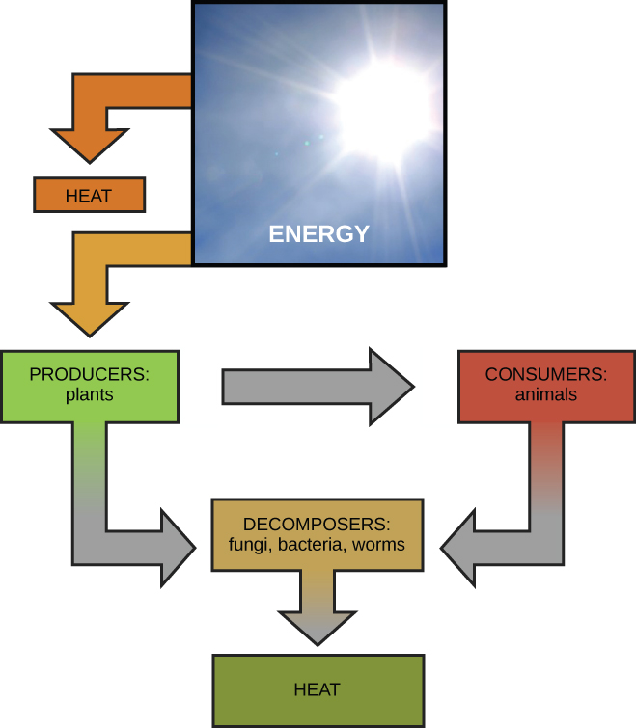
Metabolism
Most energy comes from the sun, either directly or indirectly
Most life forms on earth get their energy from the sun. Plants use photosynthesis to capture sunlight, and herbivores eat those plants to obtain energy. Carnivores eat the herbivores, and decomposers digest plant and animal matter.

Slide 3
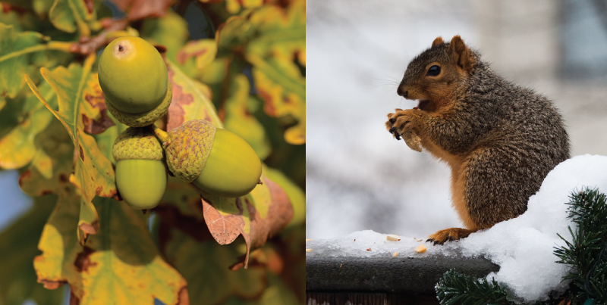
Metabolism
All living things use carbohydrates as a form of energy.
Plants, like this oak tree and acorn, use energy from sunlight to make sugar and other organic molecules. Both plants and animals (like this squirrel) use cellular respiration to derive energy from the organic molecules originally produced by plants
Free to share, print, make copies and changes. Get yours at www.boundless.com
OpenStax CNX. "OpenStax College, Energy and Metabolism. October 16, 2013." CC BY 3.0 http://cnx.org/content/m44422/latest/Figure_06_01_02.jpg View on Boundless.com

Slide 4
Metabolism
Anabolic and catabolic pathways
Anabolic pathways are those that require energy to synthesize larger molecules. Catabolic pathways are those that generate energy by breaking down larger molecules. Both types of pathways are required for maintaining the cell's energy balance.
Free to share, print, make copies and changes. Get yours at www.boundless.com
OpenStax CNX. "OpenStax College, Energy and Metabolism. October 16, 2013." CC BY 3.0 http://cnx.org/content/m44422/latest/Figure_06_01_03.jpg View on Boundless.com

Slide 5
CARBOHYDRATES

Slide 6
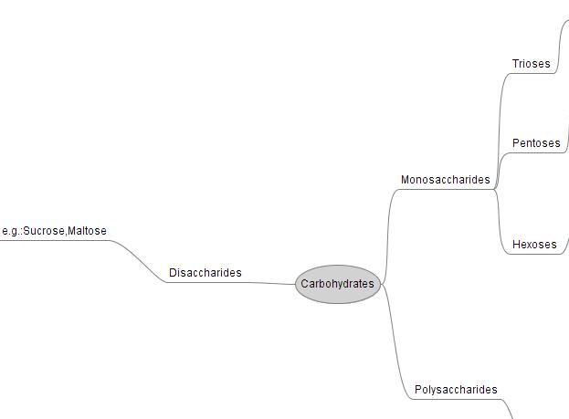
Carbohydrates
Carbohydrates are biological macromolecules that are further divided into three subtypes: monosaccharides, disaccharides, and polysaccharides

Slide 7
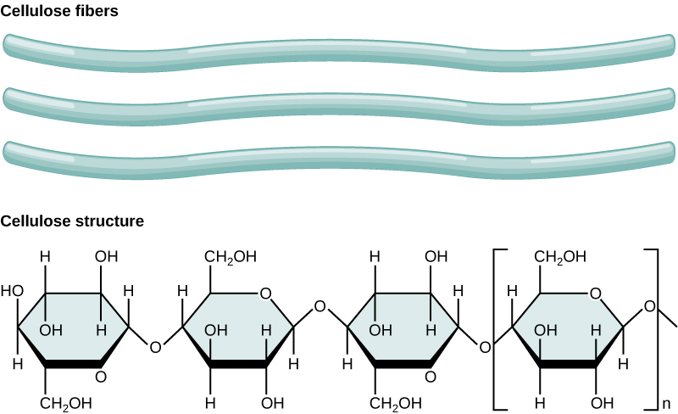
Biological Macromolecules
Polysaccharides
In cellulose, glucose monomers are linked in unbranched chains by β 1-4 glycosidic linkages. Because of the way the glucose subunits are joined, every glucose monomer is flipped relative to the next one resulting in a linear, fibrous structure.
Free to share, print, make copies and changes. Get yours at www.boundless.com
OpenStax CNX. "OpenStax College, Carbohydrates. October 16, 2013." CC BY 3.0 http://cnx.org/content/m44400/latest/Figure_03_02_07.jpg View on Boundless.com

Slide 8
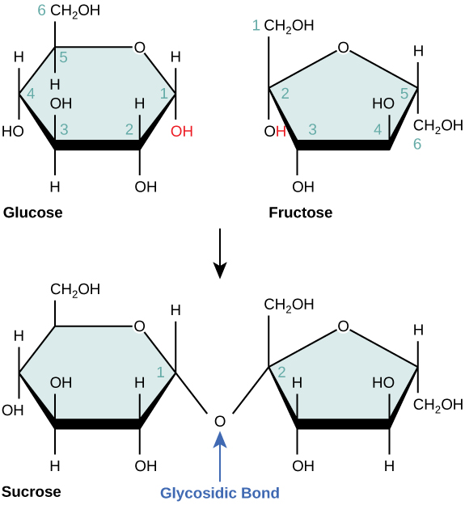
Biological Macromolecules
Disaccharides
Sucrose is formed when a monomer of glucose and a monomer of fructose are joined in a dehydration reaction to form a glycosidic bond.
Free to share, print, make copies and changes. Get yours at www.boundless.com
OpenStax CNX. "OpenStax College, Carbohydrates. October 16, 2013." CC BY 3.0 http://cnx.org/content/m44400/latest/Figure_03_02_04.jpg View on Boundless.com

Slide 9
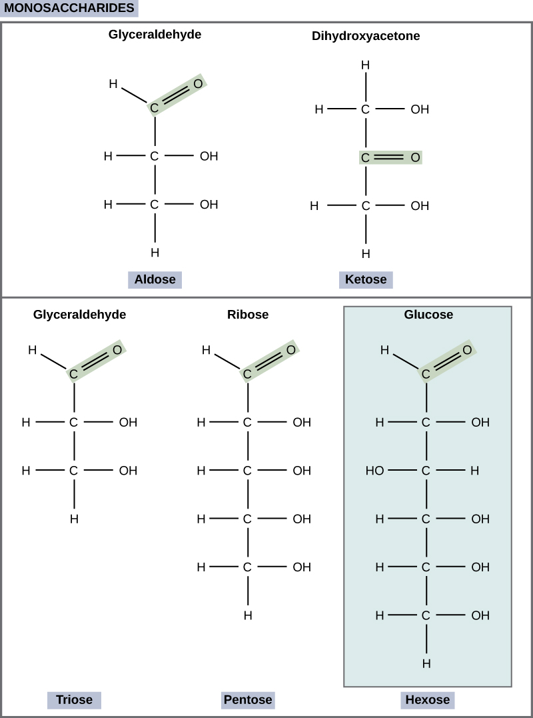
Biological Macromolecules
Monosaccharides
Monosaccharides are classified based on the position of their carbonyl group and the number of carbons in the backbone.
Trioses, pentoses, and hexoses have three, five, and six carbon backbones, respectively.
Free to share, print, make copies and changes. Get yours at www.boundless.com
OpenStax CNX. "OpenStax College, Carbohydrates. October 16, 2013." CC BY 3.0 http://cnx.org/content/m44400/latest/Figure_03_02_01.jpg View on Boundless.com

Slide 10
LIPIDS

Slide 11
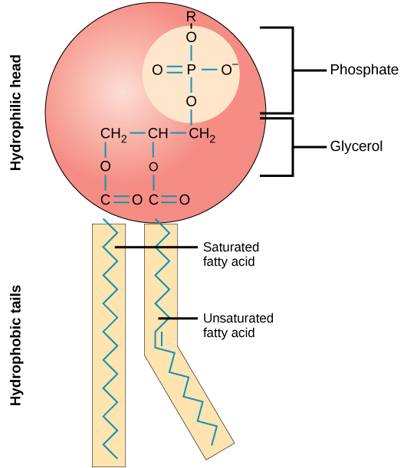
Biological Macromolecules
Phospholipid Molecule
A phospholipid is a molecule with two fatty acids and a modified phosphate group attached to a sugar based backbone and a carbon tail.
Free to share, print, make copies and changes. Get yours at www.boundless.com
OpenStax CNX. "OpenStax College, Lipids. October 16, 2013." CC BY 3.0 http://cnx.org/content/m44401/latest/Figure_05_01_03a.jpg View on Boundless.com

Slide 12
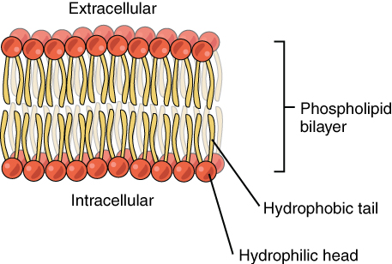
Biological Macromolecules
Phospholipid Bilayer
These lipids are found in cells.
Free to share, print, make copies and changes. Get yours at www.boundless.com
OpenStax CNX. "OpenStax College, The Cell Membrane. October 22, 2013." CC BY 3.0 http://cnx.org/content/m46021/latest/ View on Boundless.com

Slide 13
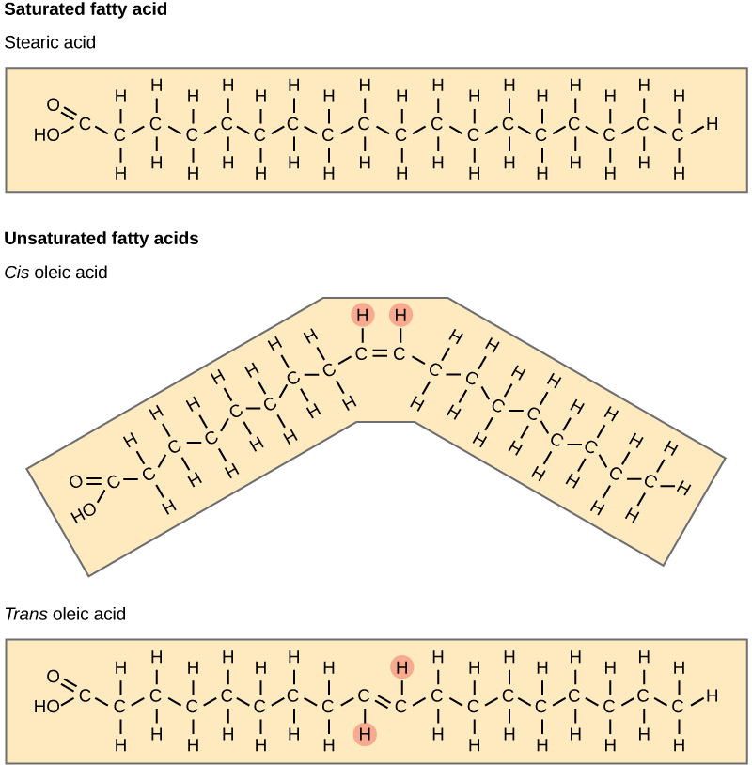
Biological Macromolecules
Fatty Acids
Saturated fatty acids have hydrocarbon chains connected by single bonds only. Unsaturated fatty acids have one or more double bonds.
Free to share, print, make copies and changes. Get yours at www.boundless.com
OpenStax CNX. "OpenStax College, Lipids. October 16, 2013." CC BY 3.0 http://cnx.org/content/m44401/latest/Figure_03_03_05.jpg View on Boundless.com

Slide 14
Amino acids and Proteins

Slide 15
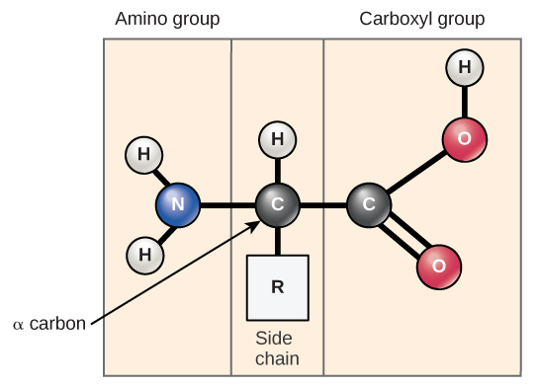
Biological Macromolecules
Amino acid structure
Amino acids have a central asymmetric carbon to which an amino group, a carboxyl group, a hydrogen atom, and a side chain (R group) are attached.
Free to share, print, make copies and changes. Get yours at www.boundless.com
OpenStax CNX. "OpenStax College, Proteins. October 16, 2013." CC BY 3.0 http://cnx.org/content/m44402/latest/Figure_03_04_01.jpg View on Boundless.com

Slide 16
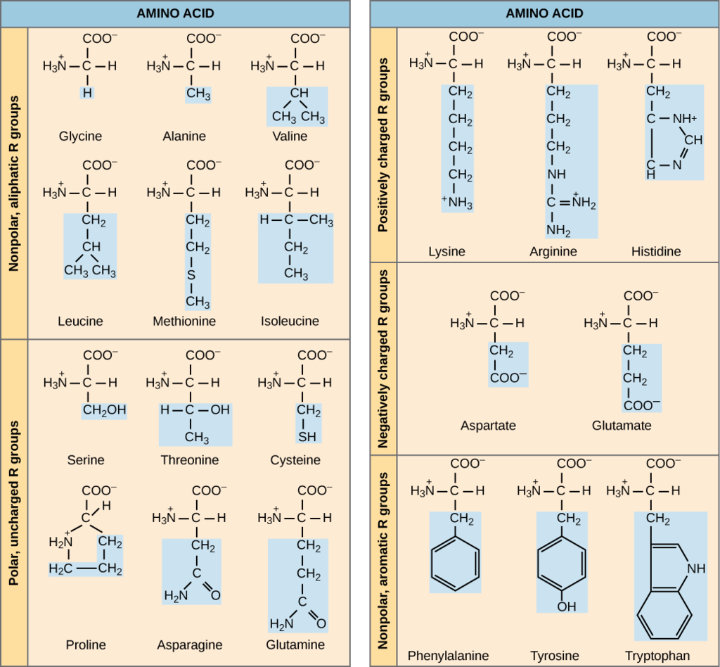
Biological Macromolecules
Types of amino acids

Slide 17
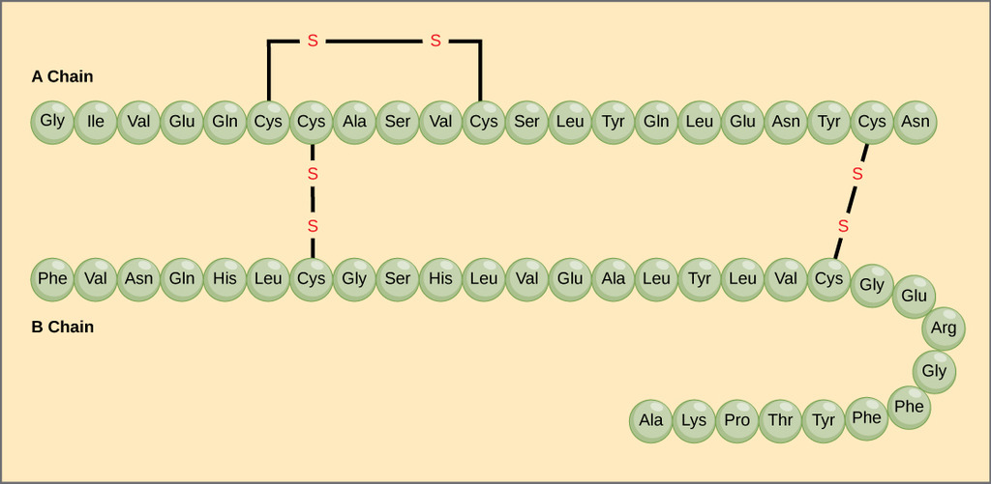
Biological Macromolecules
Primary structure
The A chain of insulin is 21 amino acids long and the B chain is 30 amino acids long, and each sequence is unique to the insulin protein.
Free to share, print, make copies and changes. Get yours at www.boundless.com
OpenStax CNX. "OpenStax College, Proteins. October 16, 2013." CC BY 3.0 http://cnx.org/content/m44402/latest/Figure_03_04_04.jpg View on Boundless.com

Slide 18
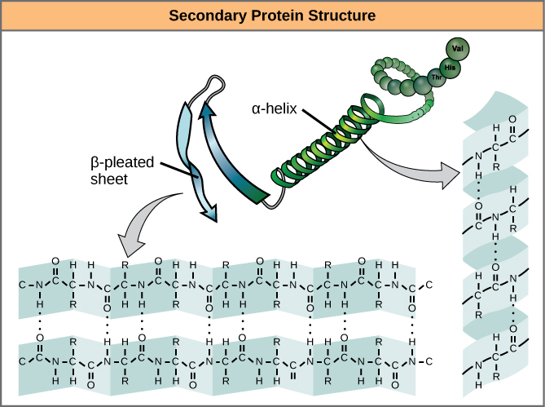
Biological Macromolecules
Secondary structure
The α-helix and β-pleated sheet form because of hydrogen bonding between carbonyl and amino groups in the peptide backbone. Certain amino acids have a propensity to form an α-helix, while others have a propensity to form a β-pleated sheet.
Free to share, print, make copies and changes. Get yours at www.boundless.com
OpenStax CNX. "OpenStax College, Proteins. October 16, 2013." CC BY 3.0 http://cnx.org/content/m44402/latest/Figure_03_04_07.jpg View on Boundless.com

Slide 19
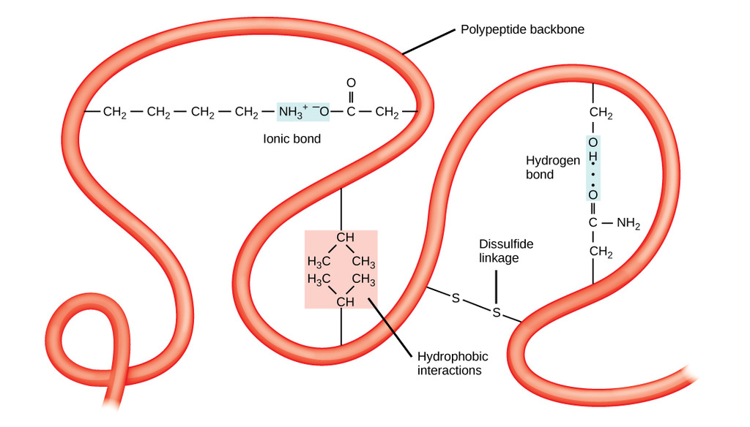
Biological Macromolecules
Tertiary structure
The tertiary structure of proteins is determined by hydrophobic interactions, ionic bonding, hydrogen bonding, and disulfide linkages.
Free to share, print, make copies and changes. Get yours at www.boundless.com
OpenStax CNX. "OpenStax College, Proteins. October 16, 2013." CC BY 3.0 http://cnx.org/content/m44402/latest/Figure_03_04_08.jpg View on Boundless.com

Slide 20
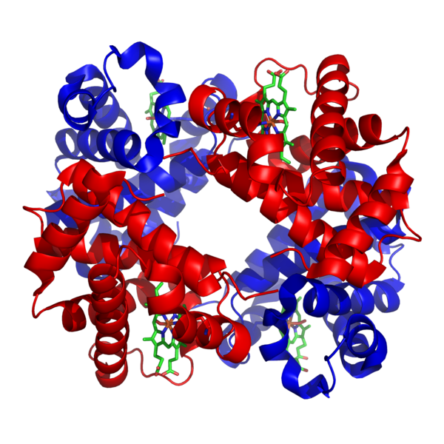
Biological Macromolecules
Free to share, print, make copies and changes. Get yours at www.boundless.com
Wikipedia. "1GZX Haemoglobin." CC BY-SA http://en.wikipedia.org/wiki/File:1GZX_Haemoglobin.png View on Boundless.com

Slide 21
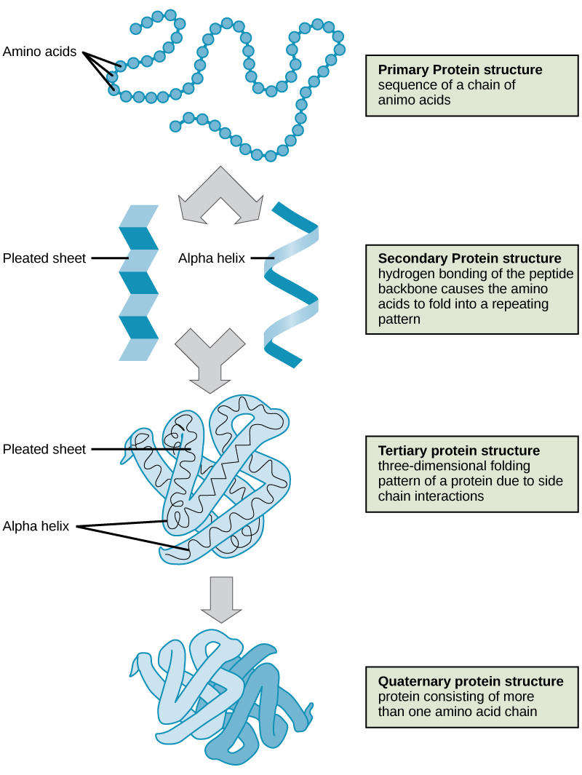
Biological Macromolecules
Free to share, print, make copies and changes. Get yours at www.boundless.com
OpenStax CNX. "OpenStax College, Proteins. October 16, 2013." CC BY 3.0 http://cnx.org/content/m44402/latest/Figure_03_04_09.jpg View on Boundless.com

Slide 22
Nucleic Acids

Slide 23
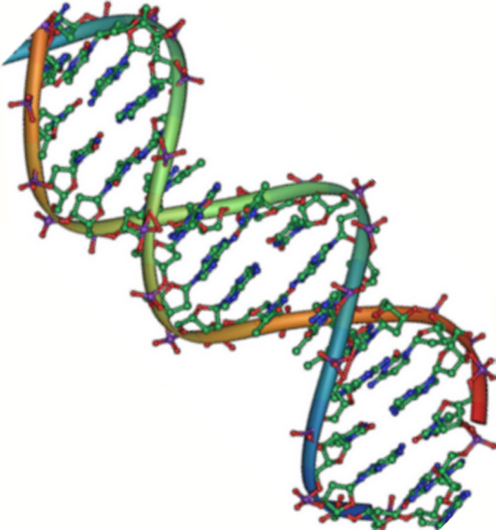
Biological Macromolecules
DNA is a Double Helix
Native DNA is an antiparallel double helix. The phosphate backbone (indicated by the curvy lines) is on the outside, and the bases are on the inside. Each base from one strand interacts via hydrogen bonding with a base from the opposing strand.
Free to share, print, make copies and changes. Get yours at www.boundless.com
OpenStax CNX. "OpenStax College, Nucleic Acids. October 16, 2013." CC BY 3.0 http://cnx.org/content/m44403/latest/Figure_03_05_02.jpg View on Boundless.com

Slide 24
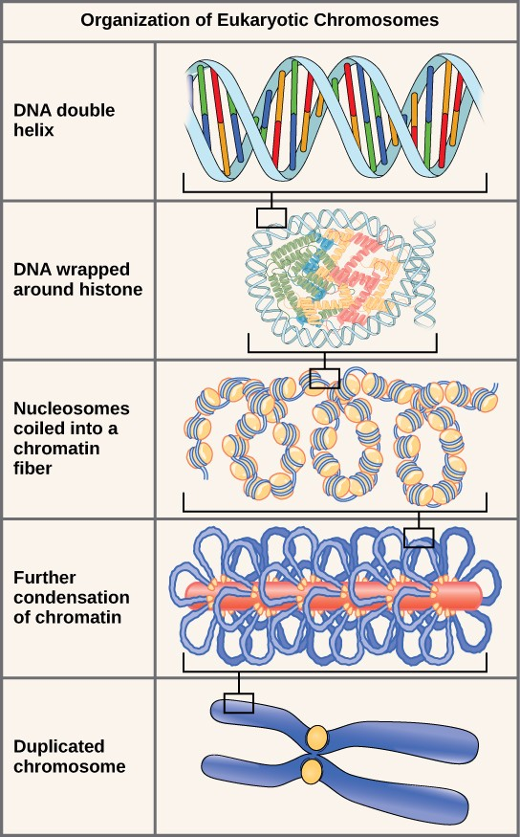
Biological Macromolecules
Eukaryotic chromosomes
These figures illustrate the compaction of the eukaryotic chromosome.
Free to share, print, make copies and changes. Get yours at www.boundless.com
OpenStax CNX. "figure7.jpg." CC BY-SA 3.0 http://cnx.org/contents/185cbf87-c72e-48f5-b51e-f14f21b5eabd@9.87 View on Boundless.com

Slide 25
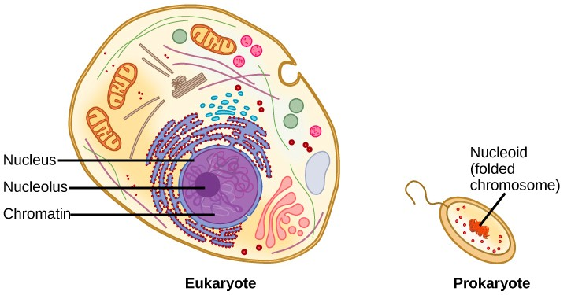
Biological Macromolecules
Eukaryotic and prokaryotic cells
A eukaryote contains a well-defined nucleus, whereas in prokaryotes, the chromosome lies in the cytoplasm in an area called the nucleoid.
Free to share, print, make copies and changes. Get yours at www.boundless.com
OpenStax CNX. "figure6.jpg." CC BY-SA 3.0 http://cnx.org/contents/185cbf87-c72e-48f5-b51e-f14f21b5eabd@9.87 View on Boundless.com

Slide 26
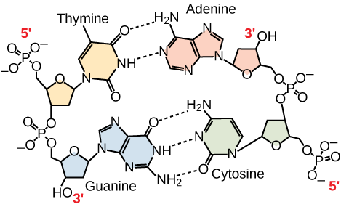
Biological Macromolecules
Antiparallel Strands
In a double stranded DNA molecule, the two strands run antiparallel to one another so that one strand runs 5′ to 3′ and the other 3′ to 5′. The phosphate backbone is located on the outside, and the bases are in the middle. Adenine forms hydrogen bonds (or base pairs) with thymine, and guanine base pairs with cytosine.
Free to share, print, make copies and changes. Get yours at www.boundless.com
OpenStax CNX. "OpenStax College, Nucleic Acids. October 16, 2013." CC BY 3.0 http://cnx.org/content/m44403/latest/Figure_03_05_03.png View on Boundless.com

Slide 27
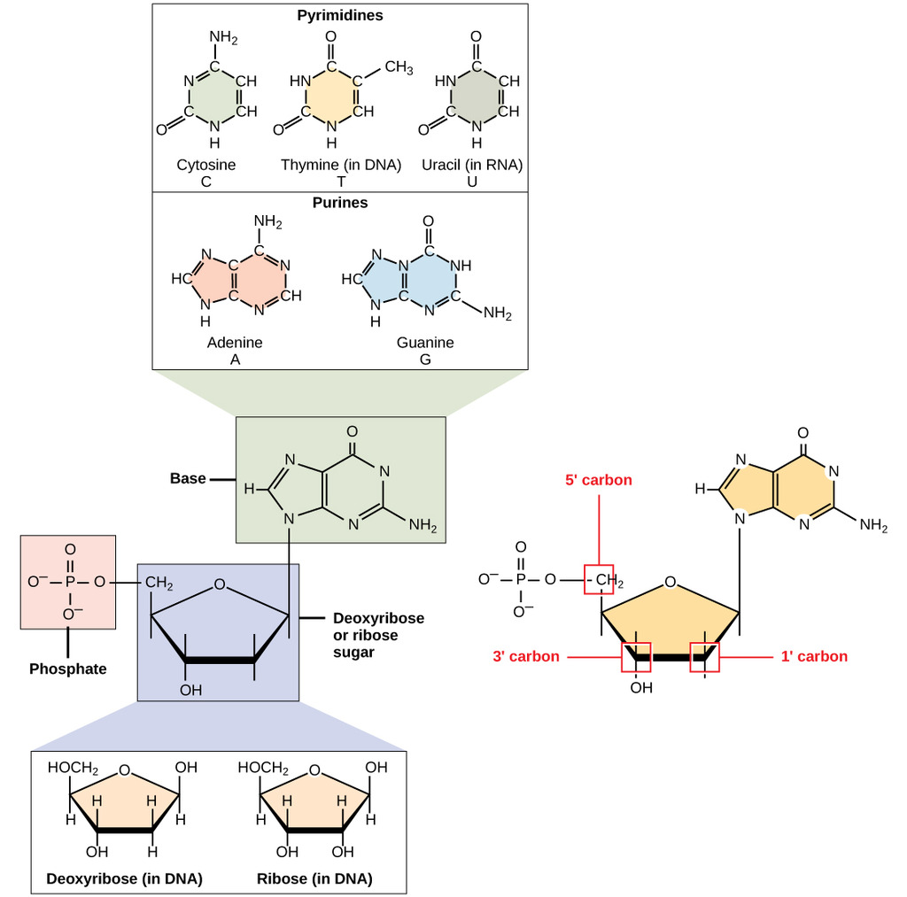
Biological Macromolecules
DNA and RNA
A nucleotide is made up of three components: a nitrogenous base, a pentose sugar, and one or more phosphate groups. Carbon residues in the pentose are numbered 1′ through 5′ (the prime distinguishes these residues from those in the base, which are numbered without using a prime notation). The base is attached to the 1′ position of the ribose, and the phosphate is attached to the 5′ position. When a polynucleotide is formed, the 5′ phosphate of the incoming nucleotide attaches to the 3′ hydroxyl group at the end of the growing chain. Two types of pentose are found in nucleotides, deoxyribose (found in DNA) and ribose (found in RNA). Deoxyribose is similar in structure to ribose, but it has an H instead of an OH at the 2′ position. Bases can be divided into two categories: purines and pyrimidines. Purines have a double ring structure, and pyrimidines have a single ring.
Free to share, print, make copies and changes. Get yours at www.boundless.com
OpenStax CNX. "OpenStax College, Nucleic Acids. October 16, 2013." CC BY 3.0 http://cnx.org/content/m44403/latest/Figure_03_05_01.jpg View on Boundless.com

Slide 28
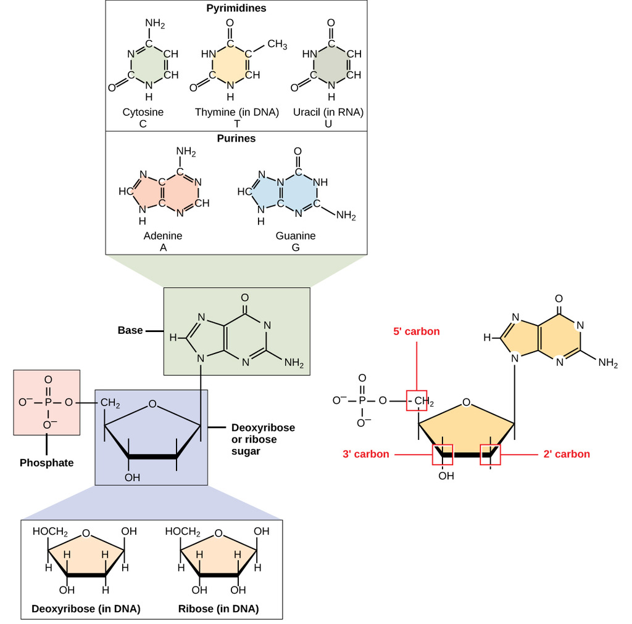
Biological Macromolecules
RNA Structure
A nucleotide is made up of three components: a nitrogenous base, a pentose sugar, and one or more phosphate groups. Carbon residues in the pentose are numbered 1′ through 5′ (the prime distinguishes these residues from those in the base, which are numbered without using a prime notation). The base is attached to the 1′ position of the ribose, and the phosphate is attached to the 5′ position. When a polynucleotide is formed, the 5′ phosphate of the incoming nucleotide attaches to the 3′ hydroxyl group at the end of the growing chain. Two types of pentose are found in nucleotides, deoxyribose (found in DNA) and ribose (found in RNA). Deoxyribose is similar in structure to ribose, but it has an H instead of an OH at the 2′ position. Bases can be divided into two categories: purines and pyrimidines. Purines have a double ring structure, and pyrimidines have a single ring.
Free to share, print, make copies and changes. Get yours at www.boundless.com
OpenStax CNX. "OpenStax College, Nucleic Acids. May 20, 2015." CC BY-SA 3.0 http://cnx.org/contents/cb178029-ce17-4c82-aa11-94a2acf4accf@8/Nucleic_Acids View on Boundless.com

