Slide 1
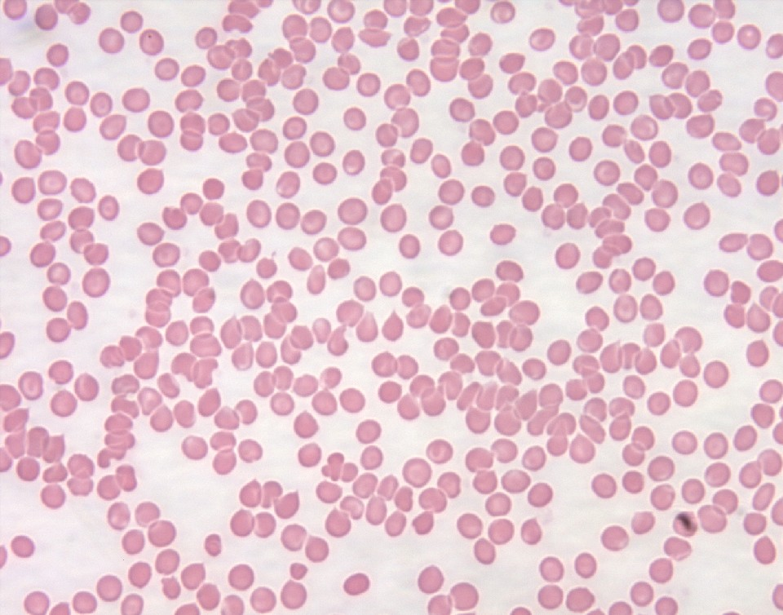
Patient A

Slide 2
Patient A
 | Patient | Normal Ranges
Hb (hemoglobin) | 14.O g/dL | Male: 13.5–16.5 g/dL Female: 12.0–15.0 g/dL
RBC (red blood cell count) | 4.7 x 10^6 | Male: 4.5–5.5 × 10⁶ cells/ml Female: 4.0–4.9 × 10⁶ cells/ml
MCV (mean corpuscular volume) | 90 | 80–100
WBC (white blood cell count) | 8576 cells/ml | 4500–10,000 cells/ml
Hex A Count | 95% | 50-100%
Platelet count | 257,840 | 100,000–450,000

Slide 3
Patient B

Slide 4
Patient B
 | Patient | Normal Ranges
Hb (hemoglobin) | 14.O g/dL | Male: 13.5–16.5 g/dL Female: 12.0–15.0 g/dL
RBC (red blood cell count) | 4.7 x 10^6 | Male: 4.5–5.5 × 10⁶ cells/ml Female: 4.0–4.9 × 10⁶ cells/ml
MCV (mean corpuscular volume) | 90 | 80–100
WBC (white blood cell count) | 8576 cells/ml | 4500–10,000 cells/ml
Hex A Count | 95% | 50-100%
Platelet count | 257,840 | 100,000–450,000

Slide 5
Patient C

Slide 6
Patient C
 | Patient | Normal Ranges
Hb (hemoglobin) | 14.O g/dL | Male: 13.5–16.5 g/dL Female: 12.0–15.0 g/dL
RBC (red blood cell count) | 4.7 x 10^6 | Male: 4.5–5.5 × 10⁶ cells/ml Female: 4.0–4.9 × 10⁶ cells/ml
MCV (mean corpuscular volume) | 90 | 80–100
WBC (white blood cell count) | 8576 cells/ml | 4500–10,000 cells/ml
Hex A Count | 95% | 50-100%
Platelet count | 257,840 | 100,000–450,000

Slide 7
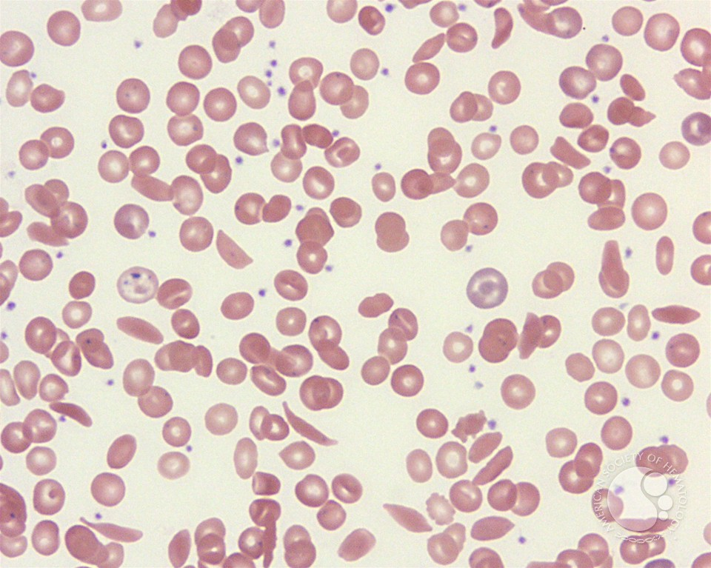
Patient D

Slide 8
Patient D
 | Patient D’s Values | Normal Ranges
Hb (hemoglobin) | 5g/dL | Male: 13.5–16.5 g/dL Female: 12.0–15.0 g/dL
RBC (red blood cell count) | 4.6 ×10⁶ cells/ml | Male: 4.5–5.5 × 10⁶ cells/ml Female: 4.0–4.9 × 10⁶ cells/ml
MCV (mean corpuscular volume) | 65 | 80–100
WBC (white blood cell count) | 15,000 cells/ml | 4500–10,000 cells/ml
Hex A Count | 100% | 50= 100%
Platelet count | 250,000 | 100,000–450,000

Slide 9
Patient E
 | Patient | Normal Ranges
Hb (hemoglobin) | 14.O g/dL | Male: 13.5–16.5 g/dL Female: 12.0–15.0 g/dL
RBC (red blood cell count) | 4.7 x 10^6 | Male: 4.5–5.5 × 10⁶ cells/ml Female: 4.0–4.9 × 10⁶ cells/ml
MCV (mean corpuscular volume) | 90 | 80–100
WBC (white blood cell count) | 8576 cells/ml | 4500–10,000 cells/ml
Hex A Count | 0% | 50-100%
Platelet count | 257,840 | 100,000–450,000

Slide 10
Patient E

Slide 11
Patient F

Slide 12
Patient F
 | Patient | Normal Ranges
Hb (hemoglobin) | 14.O g/dL | Male: 13.5–16.5 g/dL Female: 12.0–15.0 g/dL
RBC (red blood cell count) | 4.7 x 10^6 | Male: 4.5–5.5 × 10⁶ cells/ml Female: 4.0–4.9 × 10⁶ cells/ml
MCV (mean corpuscular volume) | 90 | 80–100
WBC (white blood cell count) | 8576 cells/ml | 4500–10,000 cells/ml
Hex A Count | 95% | 50-100%
Platelet count | 257,840 | 100,000–450,000

Slide 13
Patient F

