Slide 1
Complete incomplete and co- dominance + Dihybrid Crosses

Slide 2
Punnett Square review
A homozygous dominant mother (RR) is crossed with a homozygous recessive father (rr). Please complete a Punnett Square to determine the probability of the offspring inheriting a round chin.

Slide 3
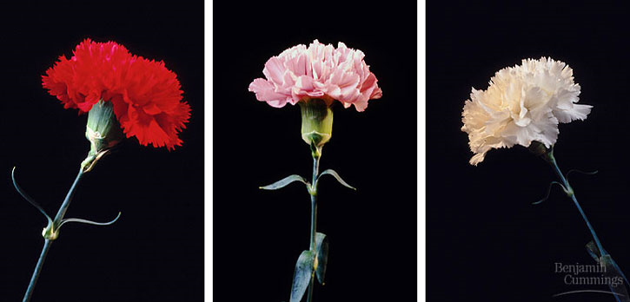
Incomplete dominance
Some traits are dominant or recessive, other traits occupy incomplete dominance.
This occurs when a heterozygous dominant genotype codes for an “intermediary” phenotype.
Example Rr= pink flowers

Slide 4
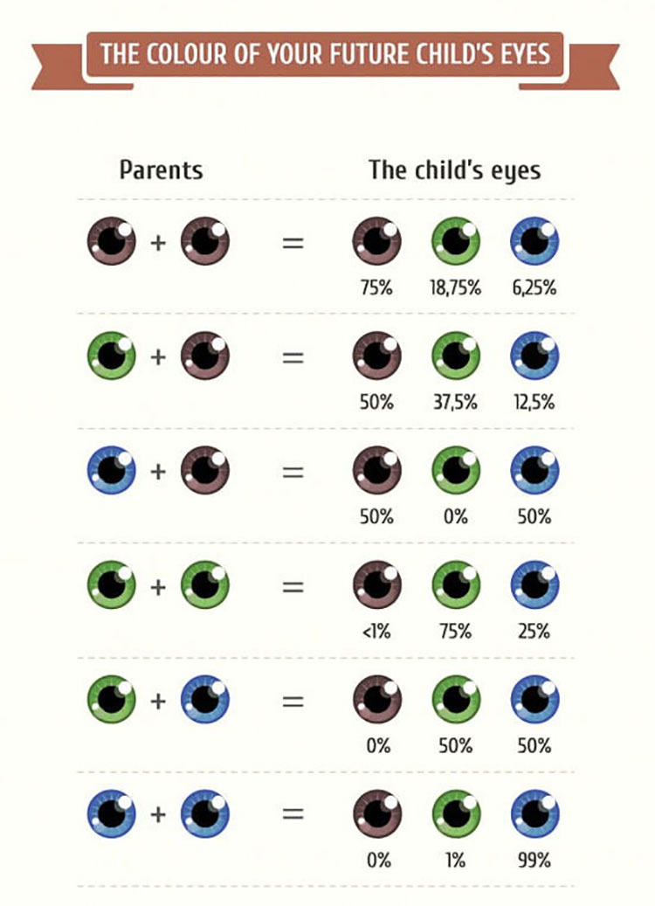
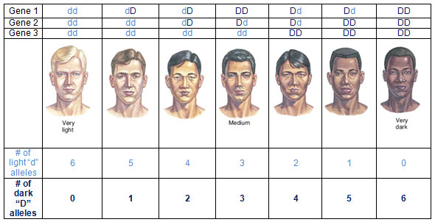
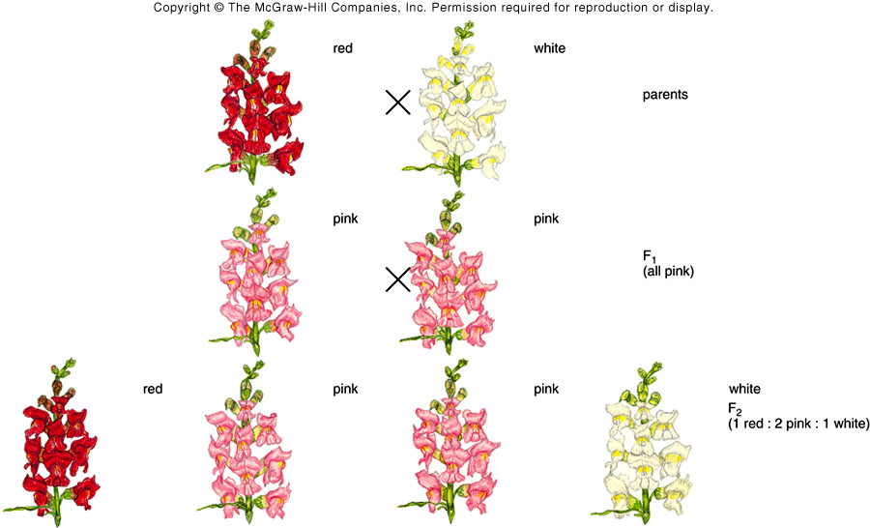
Other Examples:
Eye Color
Hair Color
Skin Color
Hair Texture
Height

Slide 5
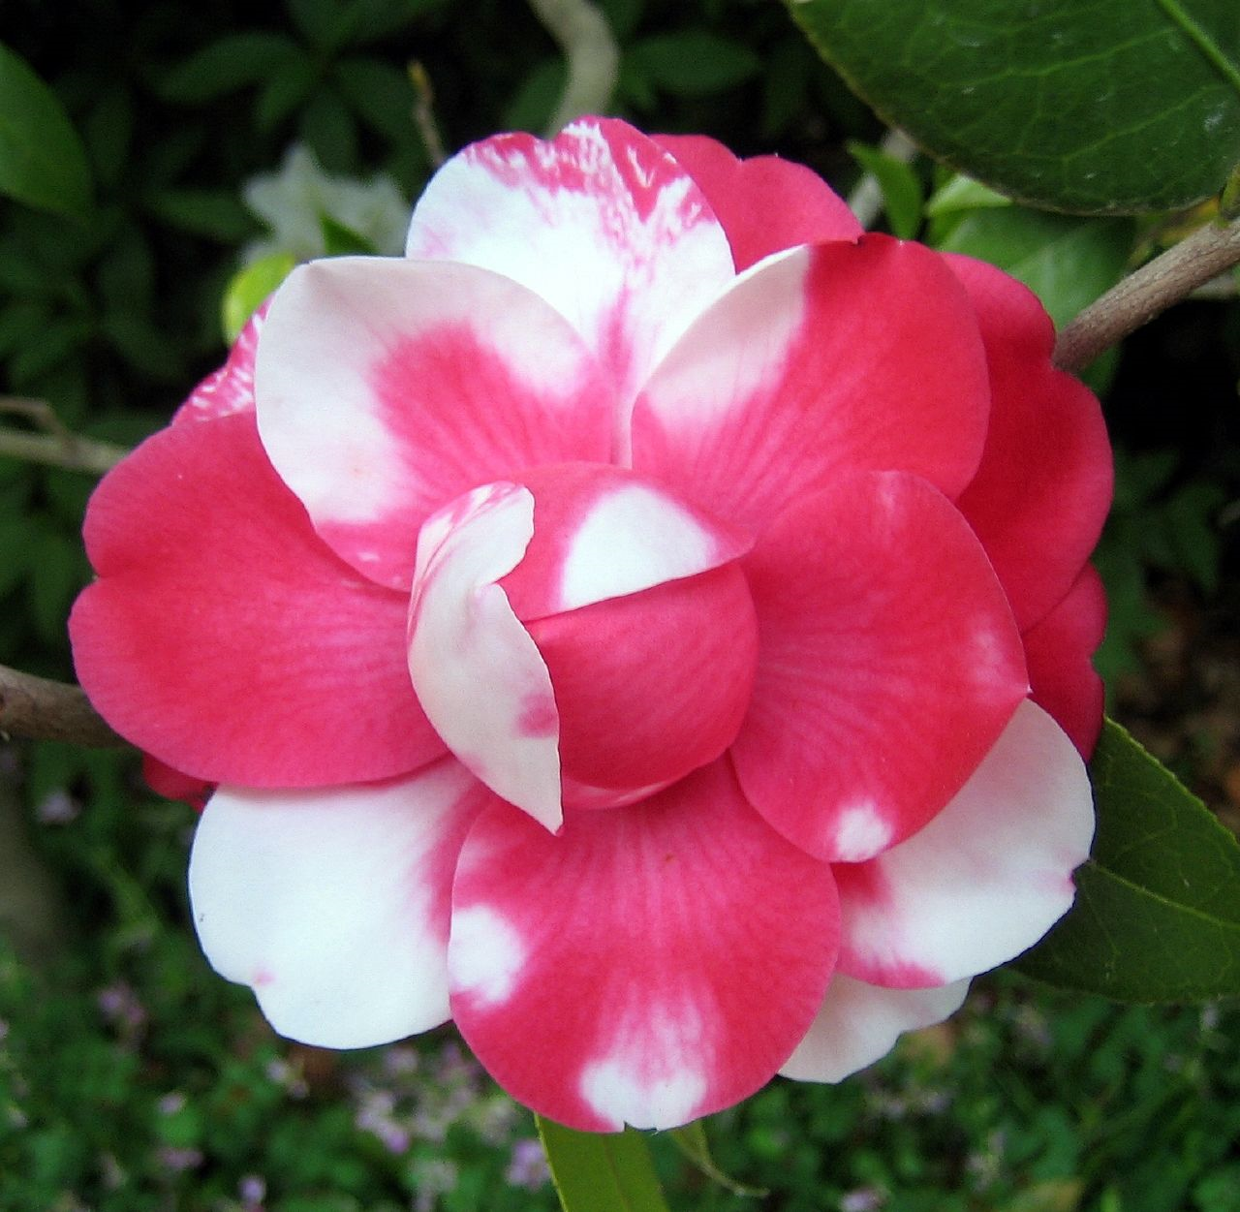
Co- dominance
When two alleles are dominant in the genotype, and present in the phenotype
Both phenotypes exist together, one is not more dominant than the other.

Slide 6
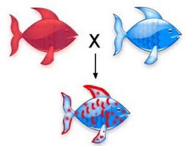
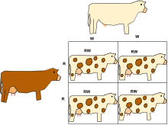
Examples

Slide 7
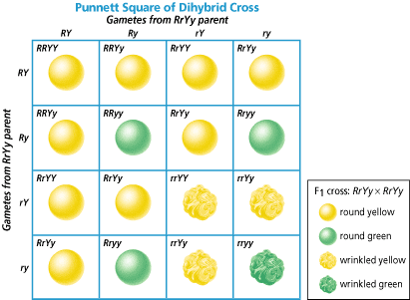
Dihybrid Crosses
Sometimes you will be asked to examine two traits.
Dihybrid crosses examine the inheritance of two different traits that are sometimes linked together
In this example, Texture and Color are inherently linked together, produces a variety of phenotypic possibilities

Slide 8
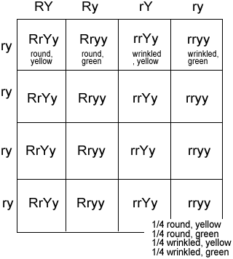
Dihybrid Cross – How do you fill it out?
Step 1: Figure out the parent’s genotypes: RrYy X rryy
Step 2: Figure out possible gametes
Use FOIL method to determine what letters go in each box
MOM (axis 1) Dad= (Axis 2)
RY -ry
Ry -ry
rY -ry
ry -ry
Step 3: Fill in the corresponding
boxes

Slide 9
Practice: Both parents homozygous
Parents = rryy and RRYY
1. FOIL for mom:
2. FOIL for dad
2. Write the foiled alleles on the axes
3. Fill in the Dihybrid cross

