Slide 2
Chromosomes, Autosomes and Sex chromosomes
Humans have 23 pairs of chromosomes
22 of these pairs are called “autosomes”
Autosomes do not determine biological sex
Numbered 1-22
1 pair of chromosomes are called “sex” chromosomes
These chromosomes primarily determine biological sex, but can also play a role in certain characteristics
These are labeled either X or Y
Males = XY
Females = XX

Slide 3
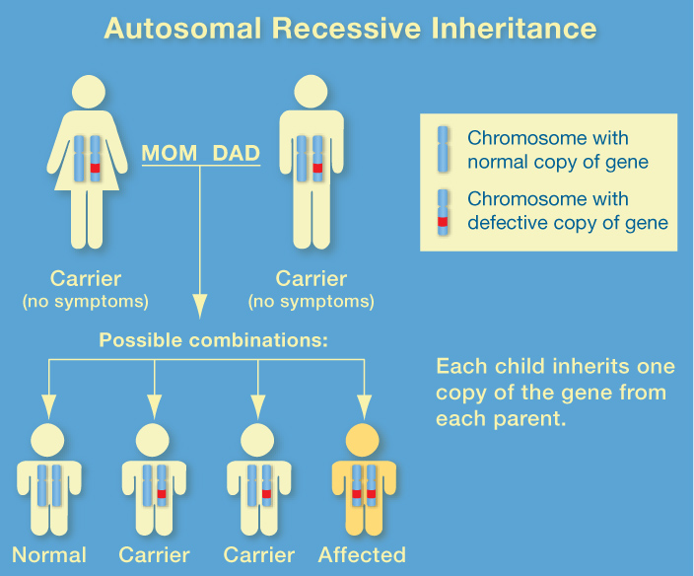
Autosomal Inheritance of recessive mutations/ Disease
Many diseases are inherited through recessive traits on autosomes EX) Cystic Fibrosis, Tay-Sachs Disease, and Sickle Cell anemia are all autosomal mutations
These diseases are Recessive, and can only be expressed if both parents carry heterozygous genes.
-can skip generations based on genotypes of parents
-affects both males and females
Someone who carries the recessive trait but does not suffer from the disease is called a “carrier”

Slide 4
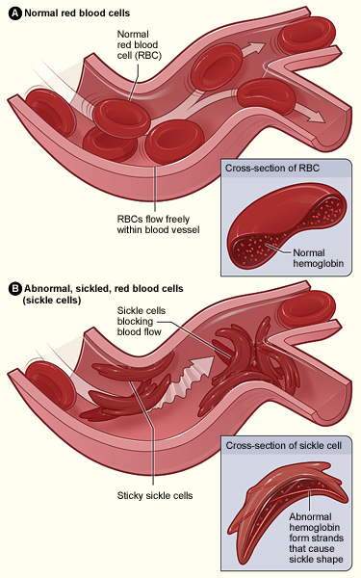

Slide 5
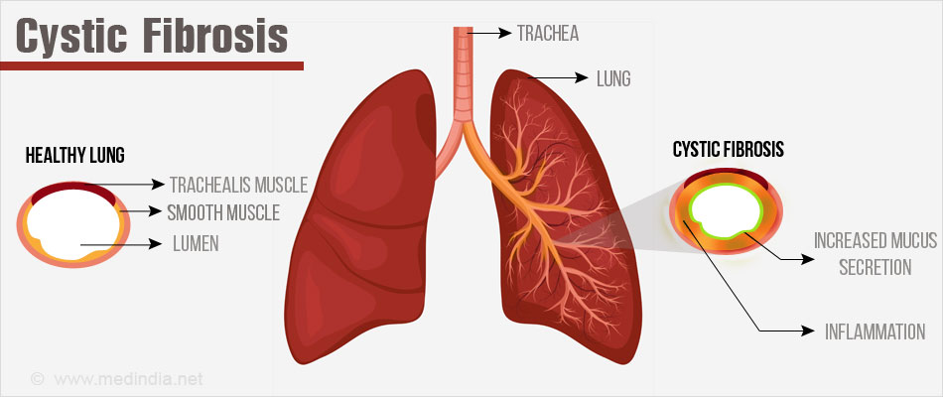

Slide 6
Autosomal Dominant Diseases
Some disease diseases are inherited through dominant traits on autosomes (non- sex chromosomes)
EX) Marfan’s Syndrome and Huntington’s disease
These diseases are dominant, and will be passed on to offspring if a parent has the Dominant trait
Affects both males and females

Slide 7
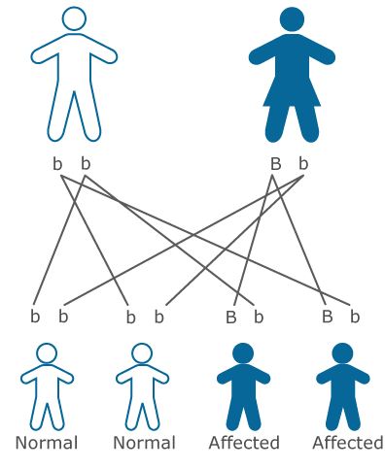
Huntington's disease is a brain disorder. It affects the person's ability to think, talk, and move.
The average life expectancy of a person who was just diagnosed is around 15 years.
However, most people diagnosed with this dominant autosomal disorder have already survived to reproduction, and may not know if they have passed on the trait to their offspring

Slide 8
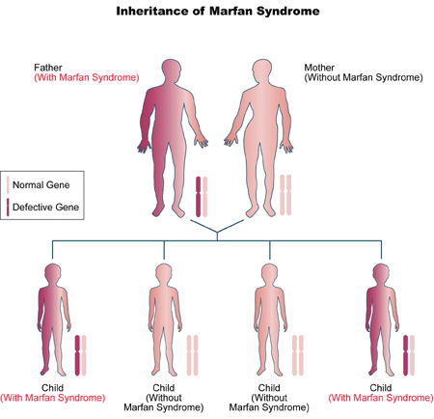
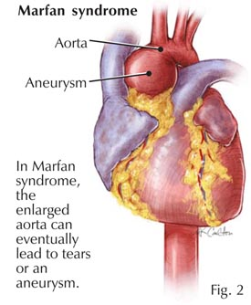
Marfan syndrome is an inherited disorder of the connective tissue that causes abnormalities of a child's eyes, cardiovascular system, & musculoskeletal system.

Slide 9
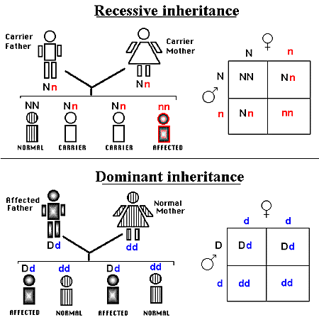

Slide 10
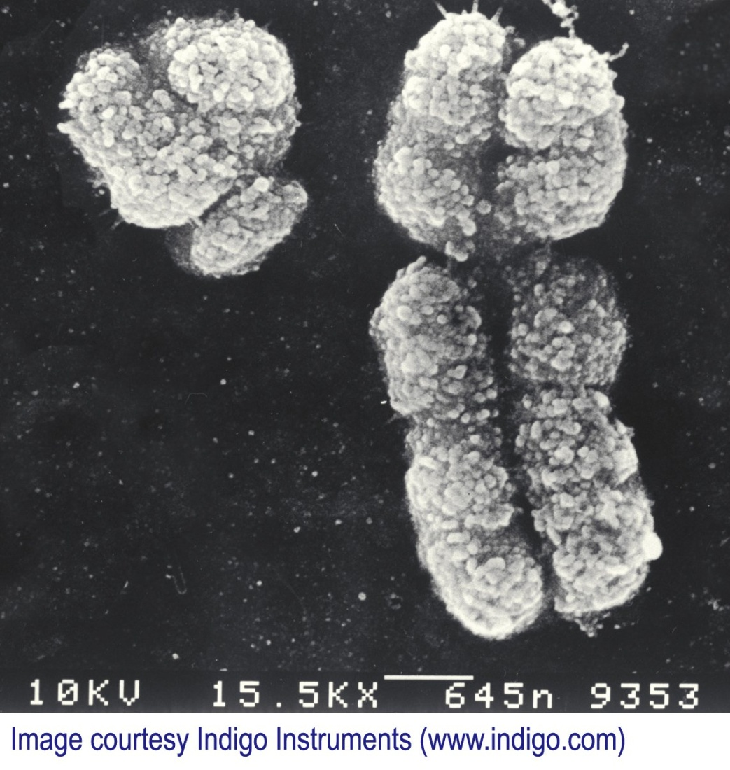
Sex (X) linked inheritance
Sex Linked inheritance affects the X and Y chromosomes
In your groups, come up with a possible answer to the question below:
What happens when an offspring has a mutation on the X chromosome if they are female?
What if they are male?

Slide 11
Sex (X) linked inheritance
Sex Linked inheritance affects the X and Y chromosomes
Since women have two copies of the X chromosome, if there is a mutation on one, diseases are not automatically inherited
However, if a male inherits a mutated X chromosome, the chances of disease are much higher

Slide 12
Sex linked inheritance Dominant
Dominant gene on X chromosome
Affected males pass to all daughters and none of their sons
Genotype= X^{A}Y
If the mother has an X- linked dominant trait and is homozygous (X^{A}X^{A}) all children will be affected
If Mother heterozygous (X^{A}Xª) 50% chance of each child being affected
E.g. dwarfism, rickets

Slide 13
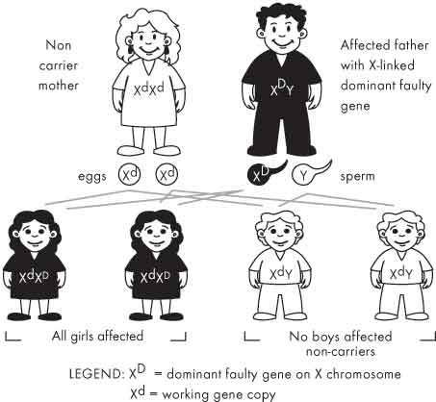
Sex linked inheritance Dominant

Slide 14
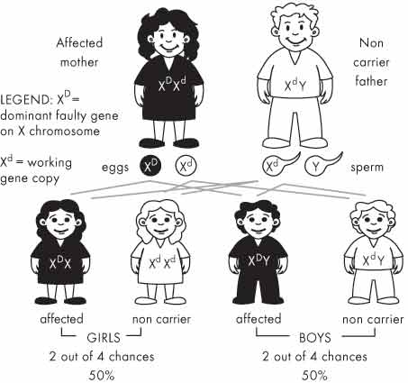

Slide 15
Sex linked Inheritance Recessive
Gene located on the X chromosome
Males cannot be carriers (only have 1 X so either affected or not)
More males than females affected (males inherit X from mother)
Females can only inherit if the father is affected and mother is a carrier or affected
An affected female will pass the trait to all her sons
Daughters will be carriers if father is not affected
Can skip generations
E.g. colour blindness, haemophilia, Duchene muscular dystrophy

Slide 16
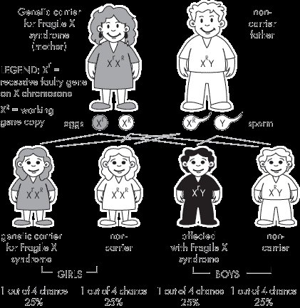
Sex linked Inheritance Recessive

Slide 17
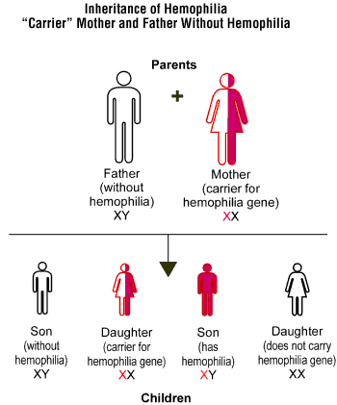
Hemophilia is a rare, inherited bleeding disorder in which your blood doesn’t clot normally. If you have hemophilia, you may bleed for a longer time than others after an injury. You also may bleed internally, especially in your knees, ankles, & elbows. This bleeding can damage your organs or tissues &, sometimes, be fatal.

