Slide 1
Sex linked inheritance and meiotic errors

Slide 2
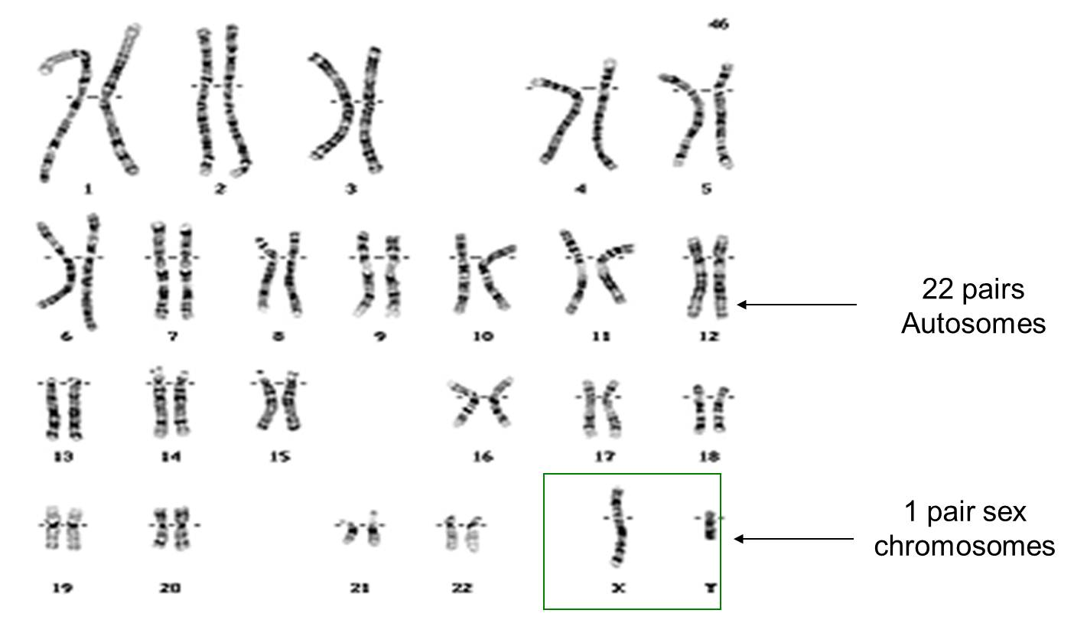
Sex Linked diseases
Mainly occur when there is a mutation on a gene on the X chromosome.
Since men only have 1 X chromosome, sometimes sex linked diseases occur only in men.
The Y chromosome is not being enough to hold any vital genes. Which is why sex linked disorders MOSTLY occur on the X chromosome.

Slide 3
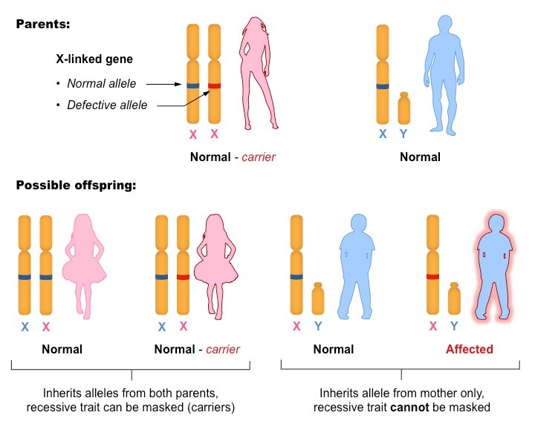

Slide 4
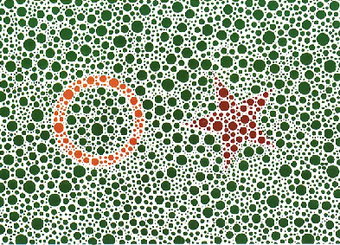
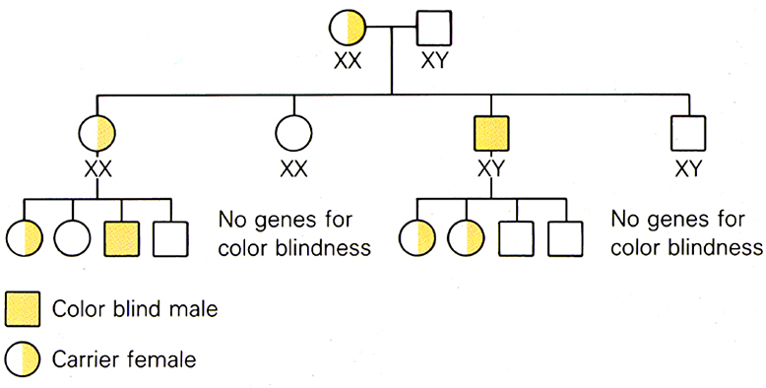
Color Blindness
Color-blindness
Baldness

Slide 5
X-Linked Dominance
Similar to X-linked recessive alleles, except the allele is also expressed in heterozygous females
Examples: faulty enamel (of the teeth) trait

Slide 6
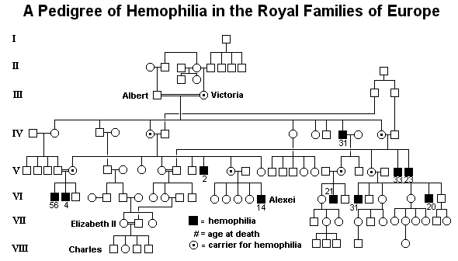
Hemophilia A
Inability of blood to clot because genes do not code for clotting agent(s)

Slide 7
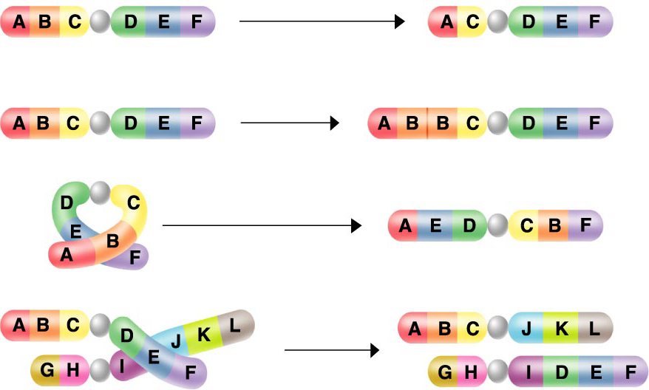
Chromosomal Mutations
Deletion
Duplication
Inversion
Translocation
Nondisjunction

Slide 8
Meiotic errors/chromosomal abnormalities
When cells have too many copies on one or more chromosomes. Rather than have two pairs of homologous chromomosomes, affected individuals might have three copies of chromosomes, or only one.
Mutations might also affect specific genes, genes may be erased, duplicated, or in the wrong order

Slide 9
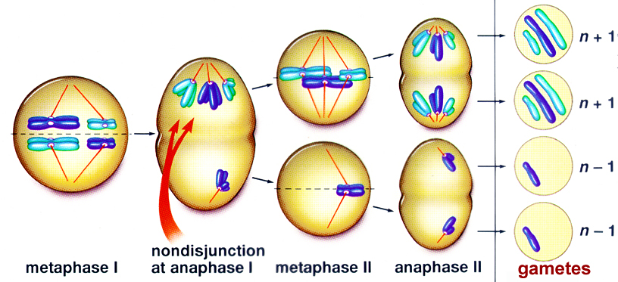
Meiotic Errors
Nondisjunction- homologues don't separate in meiosis 1

Slide 10
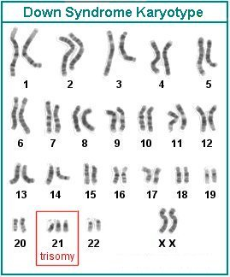
Trisomy 21
“Down’s Syndrome”
Occurs more frequently in children born to older women and men
  1: 80 births after 40 yrs
  1: 40 births after 45 yrs

Slide 11
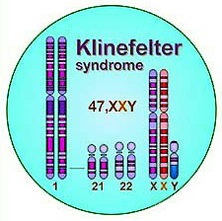
Klinefelter Syndrome
XXY condition
  Most from non-disjunction in mother
  Tall, some mental slowness
  Poor male sex organ development; breast development; usually sterile

Slide 12
Cri-du-Chat
Deletion or translocation of material from 5th chromosome
  “Cry of the Cat” (French) – sound many children make when crying
  Severely disabled individuals

Slide 13
Turner Syndrome
XO
  Females with only one X chromosome, mostly due to nondisjunction in father
  Most are spontaneously aborted
  Sterile, short stature, heart defects, premature aging, shorter lives
YO = LETHAL

Slide 14
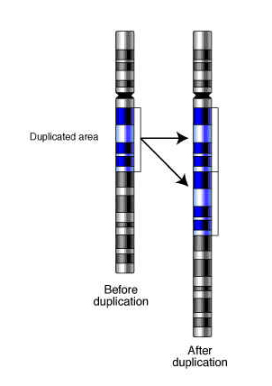
Duplications
Fragile X syndrome
  Intellectual disability
  Repeats that may block
  expression of gene on
  X chromosome

