Slide 1
ECOLOGY

Slide 2
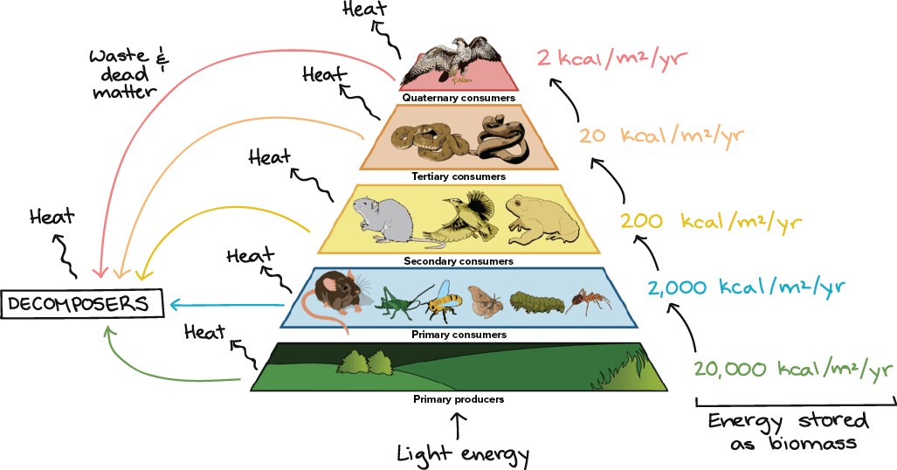
ECOLOGY
Interactions and Interdependence
Ecology is the scientific study of interactions among organisms and between organisms and their environment, or surroundings.

Slide 3
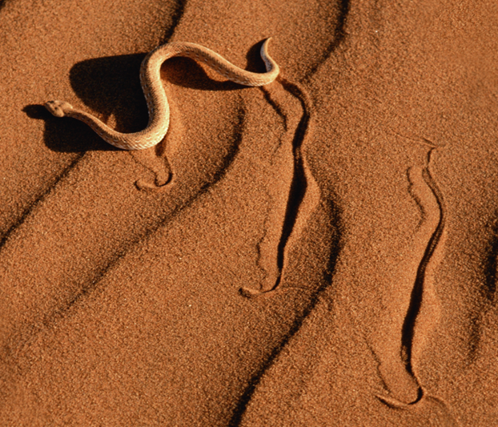
Biotic and Abiotic Factors
Ecosystems are influenced by a combination of biological and physical factors.
Biotic= Living factors such as plants, other animals, microorganisms etc…
Abiotic= non living factors, physical characteristics of the ecosystem (mountains, rocks, rivers, natural disasters, weather patterns

Slide 4
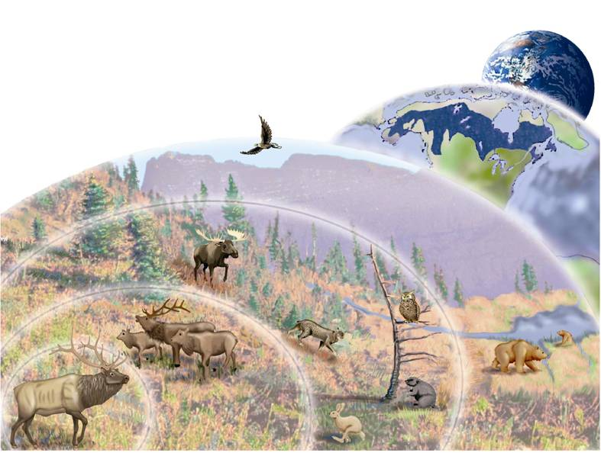
Levels of Organization
The Internet
Biosphere
Spotify
Biome
Pop Music
Ecosystem
Community
Beyonce
Population
Lemonade
Individual
Formation
Notes:
The study of ecology ranges from the study of an individual organism to populations, communities, ecosystems, biomes—and, finally, to the entire biosphere. The information that ecologists gain at each level contributes to our understanding of natural systems.

Slide 5
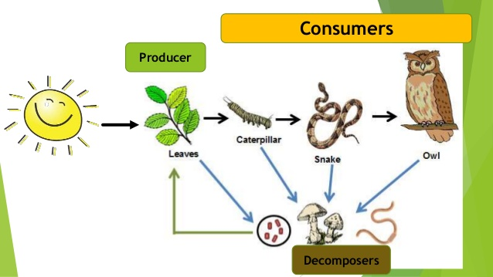
Types of Organisms
Consumers- get energy from eating other organisms
Producers- get energy from the sun via photosynthesis
Decomposers – return nutrients back the to soil by eating dead organisms.

Slide 6
Phototrophs
Producers: Use sun energy to produce sugars (autotrophs)
How do they do it?
Photosynthesis!

Slide 7
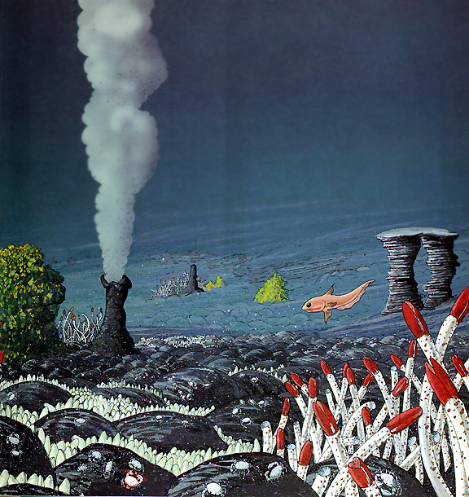
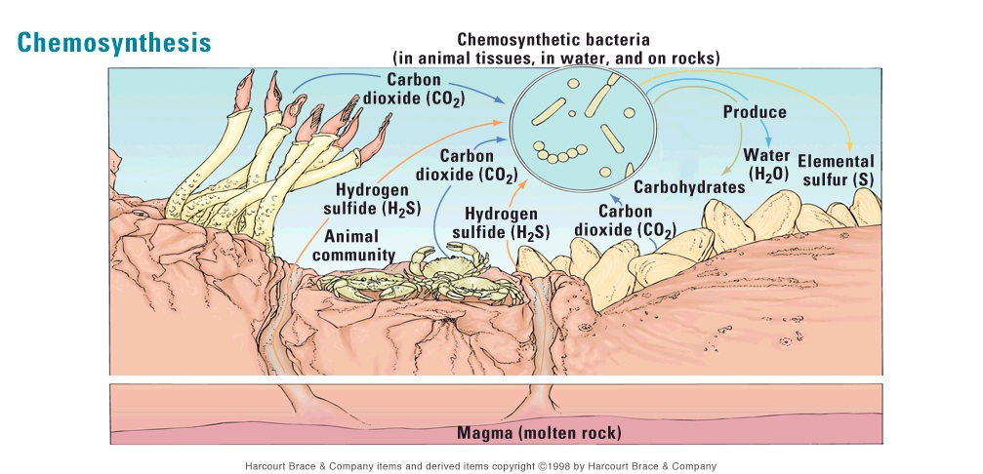
Chemotrophs
Producers: Use H₂S to produce sugars (chemo-synthesis)
Bacteria

Slide 8
Chemotrophs
Another type of producer

Slide 9
Heterotrophs
Consumers: Break down stored sugars (aerobic respiration)
sugar + O2 ----> CO2 + H2O+Energy
Primary Consumers = Herbivores
Secondary Consumers: Carnivores
Tertiary Consumers: TOP Carnivores

Slide 10
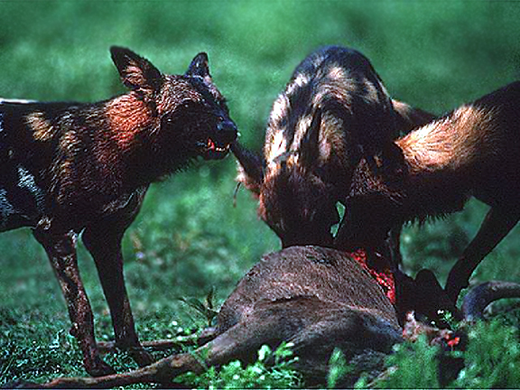

Slide 11
Heterotrophs
Other Consumers: Omnivores

Slide 12
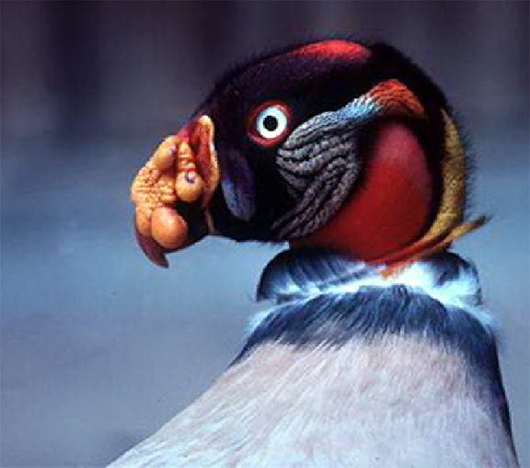
Decomposers
Primary Decomposers: Feed off dead organic matter in soil, release nutrients
Secondary Decomposers: Break down tissue into basic nutrient; goes back to plants

Slide 13
Food chain
Energy flows through an ecosystem in
one direction, from the sun or inorganic
compounds to autotrophs (producers)
and then to heterotrophs (consumers).

Slide 14
FOOD WEBS
Show multiple ways energy can move through an ecosystem
The more connections, the more stable the ecosystem

Slide 15
How efficient is the
transfer of energy among organisms in an ecosystem?
Organisms are not 100% efficient
Only 10% of the energy at one level makes it to the next level (90% lost as heat into the atmosphere)

Slide 16
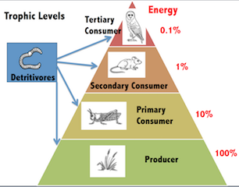
Trophic Levels
Usually no more than 3-4 trophic levels in a food chain
Fewer and fewer organisms in the food chain as you go up

Slide 17
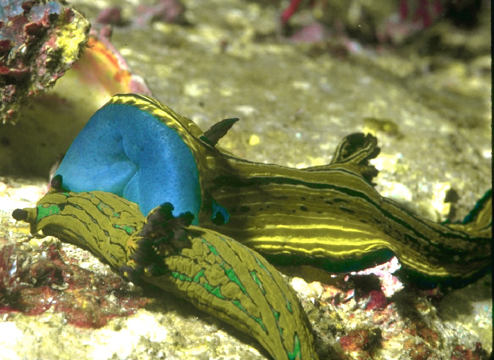
Community Interactions
Community interactions, such as competition, predation, and various forms of symbiosis, can affect an ecosystem.

Slide 18
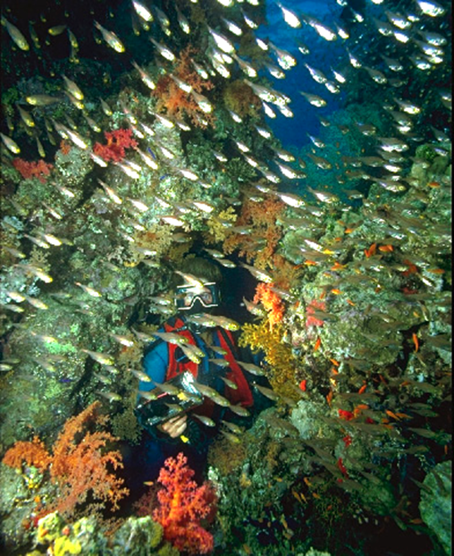
Competition
Between SAME species; intense,
DIFFERENT species; less intense;

Slide 19
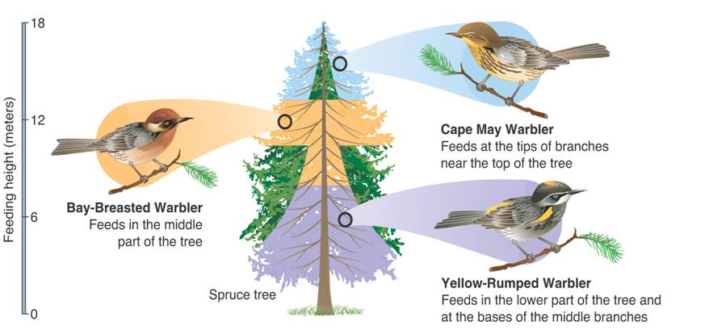
Community Interactions
How are these warblers avoiding competition? Notice where they live…
Notes:
Each of these warbler species has a different niche in its spruce tree habitat. By feeding in different areas of the tree, the birds avoid competing with one another for food.

Slide 20
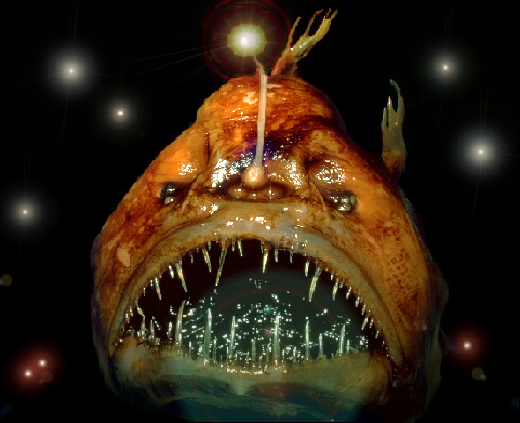
Community Interactions
Predation
An interaction in which one organism captures and feeds on another organism is called predation.

Slide 21
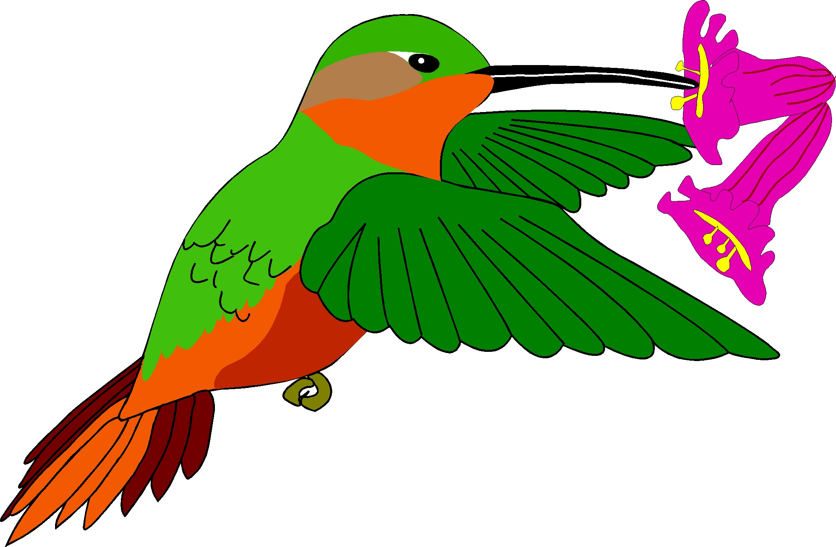
Community Interactions
Symbiosis
Any relationship in which two species live closely together is called symbiosis.

Slide 22
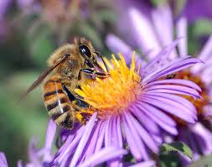
Mutualism
Helpful to BOTH species
Ex: bees and flowers

Slide 23
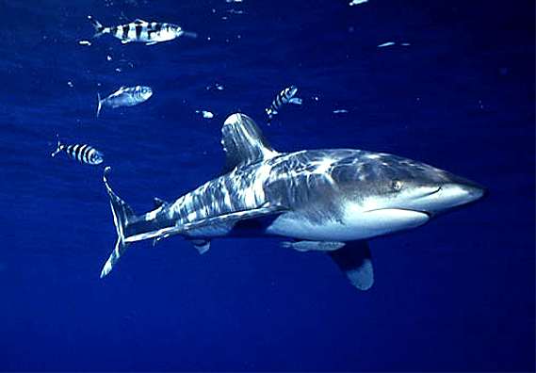
Commensalism
One member is helped, the other neither benefits or is harmed

Slide 24
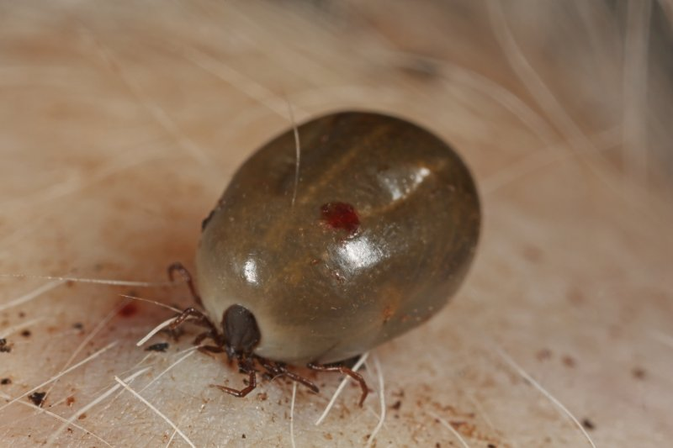
Parasitism
+ and – relationship
Parasite benefits, host loses

