Slide 1
Quiz Corrections
Please Take a look at your quiz and take out a colored pen
In your notebook, complete the following:
For every question that was IN-correct, find the correct answer and explain WHY that is the correct answer
Tell me what you are going to do to make sure you don’t make the same mistake on another test.

Slide 2
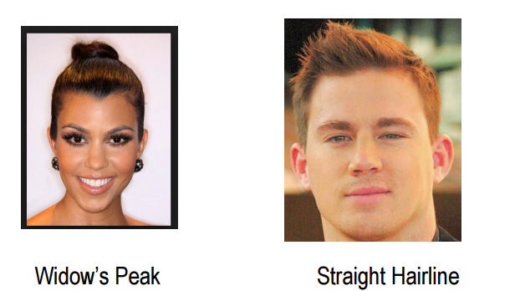
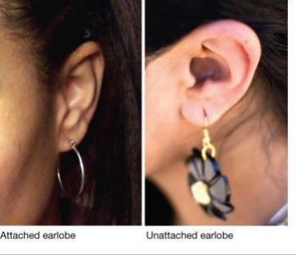
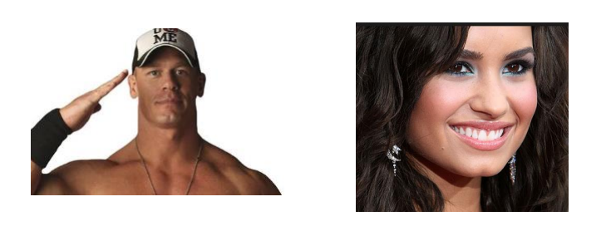
Traits inventory
Turn to your seat partner and help each other determine which traits you two exhibit.
Attached or unattached earlobe
Cleft chin or round chin
Straight hairline or a widow’s peak hairline
Dimples or no dimples
Rolled tongue/ clover tongue or nothing special

Slide 3
Attached Earlobe | Round Chin | Widow’s peak | Dimples | No rolled Tongue

Slide 4
Which Traits are more frequent?
Why are some of our traits more frequent than others?

Slide 5
MENDELIAN GENETICS
Write the words in black

Slide 6
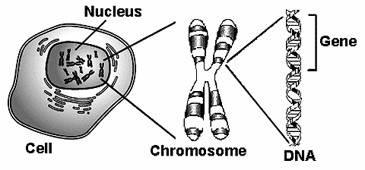
RECALL Genes encode proteins that produce a diverse range of traits.

Slide 7
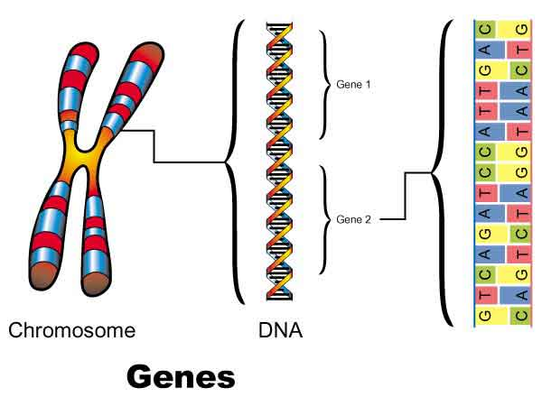
GENES AND CHROMOSOMES
Chromosomes are tightly bundled coils of DNA
Certain segments of DNA that code for specific traits or proteins are called genes

Slide 9
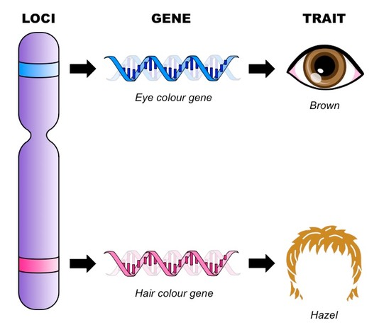
What is a gene?
A gene is a section of DNA that directs a cell to make a certain protein.
Each gene has a locus, a specific location on a pair of homologous chromosomes.

Slide 10
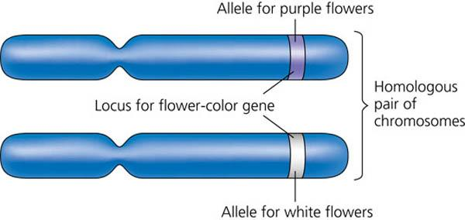
Genes occur at a specific location on a chromosome and makes specific traits
Homozygous describes two alleles that make the same type of trait.
Heterozygous describes two alleles that make different types of traits.
BB
bb
Each parent donates one type of gene for every chromosomal loci.
Alleles are different versions of the same trait

Slide 12
Genes influence the development of traits.
A genotype refers to gene and its accompanying DNA sequence.
A phenotype is the physical expression of a trait.
BB might actually represent a large DNA sequence:
“gagttcgatagagtgcgagcgtgagtggtgagcggtgagcgtgtgagagagaattcgcgcga”
BB= Genotype
BB
bb
The different types of DNA sequences are abbreviated with either small or large letters
Purple and White = Phenotype. These are physical representations

Slide 13
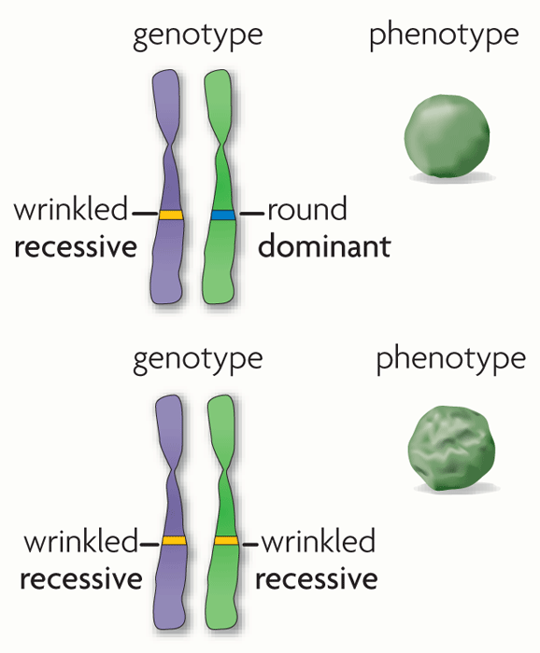
Alleles can be represented using letters.
Dominant alleles are represented by uppercase letters; recessive alleles by lowercase letters.
Dominant genes are expressed as a phenotype even when only one allele is dominant .
Recessive genes are expressed as a phenotype when two copies of the recessive allele are present.

Slide 14
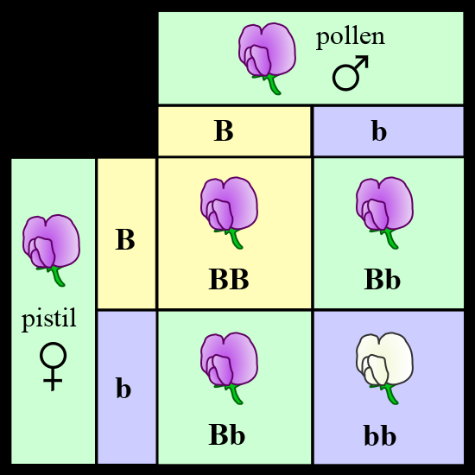
Punnett Squares
Punnett squares can help us mathematically determine the probability of inheriting certain traits

Slide 15
How does it work?
Genotypes
of parents
Possible
genotypes
of offspring

Slide 16
Punnett Squares
Step 1: Figure out the parent’s genotypes and fill it in on the X & Y axis.
Step 2: Fill in the individual alleles down each column/ row

Slide 17
So what? Why do we need it?
We can use it to predict the probability a child’s genotype and phenotype
Ww = Straight hairline
ww = Widow’s Peak
 | W | W
w | Ww | Ww
w | Ww | Ww

Slide 18
Probability Vs. Ratios
BB = 1 homozygous dominant
Bb = 2 Heterozygous Dominant
bb = 1 Homozygous recessive
the ratio is 1:2:1
What about probabilities?
75% chance the flower will be purple
25% chance the flower will be white
COUNT how many times each genotype occurs.

Slide 19
Question #1: Create the Punnett Square determine the ratios, and calculate probabilities
A green pea plant (Gg) is crossed with a yellow pea plant (gg).
Ratio:
_______ : ________ : ________
Probability of green pea plant:
Probability of yellow pea plant:

Slide 20
Exit Ticket!
A tall plant that is homozygous dominant (TT) is crossed with a tall plant that is heterozygous (Tt).
Ratio:
_______ : ________ : ________
Probability of tall plant
Probability of short plant:

