Slide 1
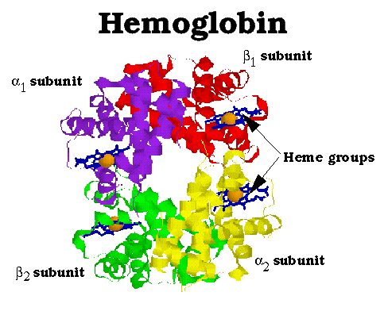
DNA & Protein Synthesis
Vocabulary:
DNA
Nucleotide
Base Pairing
Messenger RNA (mRNA)
Ribosomal RNA (rRNA)
Transfer RNA (tRNA)
Transcription
Polymerase
Promoter
Intron
Exon
Codon
Translation
Anticodon

Slide 2
DNA
DeoxyRibo-Nucleic Acid
A molecule made up of nucleotide base pairs which determines the genetic make-up of an organism

Slide 3
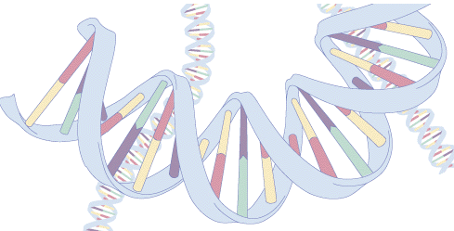
What DNA does…
Carries information from one generation to the next
Put that information to work by determining heritable characteristics
Must be easily copied since almost every new cell gets a copy

Slide 4
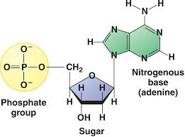
DNA Structure
Made up of nucleotides
Each composed of 3 parts:
Deoxyribose: sugar
Phosphate group
Nitrogenous (nitrogen containing) base
Adenine (A)
Thymine (T)
Guanine (G)
Cytosine (C)

Slide 5
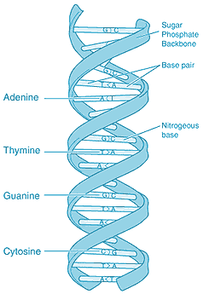
Backbone: the sugar groups and the phosphate groups
“Steps of Ladder:” connected base pairs
Adenine
Thymine
Guanine
Cytosine

Slide 6
How the bases pair in DNA…
A T (A pairs with T)
C G (C pairs with G)

Slide 7
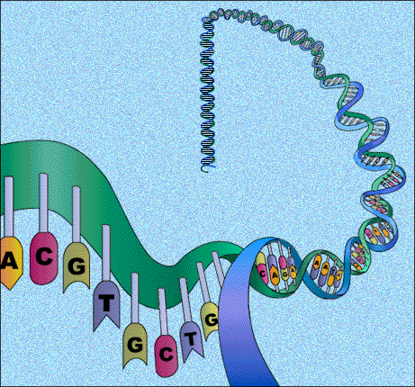
What’s holding the strands together?
HYDROGEN BONDS!!!
Hydrogen Bonds will only form between A and T base pairs as well as between C and G base pairs – this is the principle of base pairing

Slide 8
Okay so we have DNA, how does it affect our body’s function?
DNA holds the code to help the body make proteins.
There are a series of processes that allow for the information contained in DNA to be turned into functional proteins
These processes are called transcription and translation

Slide 9
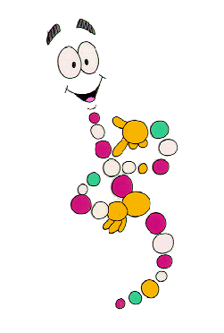
The Importance of Proteins
Proteins are diverse!
They control chemical messages in cell
Direct the synthesis of carbohydrates, lipids and act as enzymes
Give the cell structure and movement

Slide 10
Quick Review of Proteins
Made of amino acids
There are only 20 amino acids to make up a lot of proteins
Proteins are a major component of cells
Proteins are made in ribosomes

Slide 11
PROTEIN SYNTHESIS
DNA
Step 1. TRANSCIPTION
(nucleus)
mRNA
Step 2. TRANSLATION
(ribosome)
tRNA
PROTEIN

Slide 12
RNA
Like DNA, made of nucleotides
Disposable copy of DNA segment
3 differences:
1) sugar= ribose
2) single stranded
3) instead of the base thymine (T), RNA uses uracil (U)

Slide 13
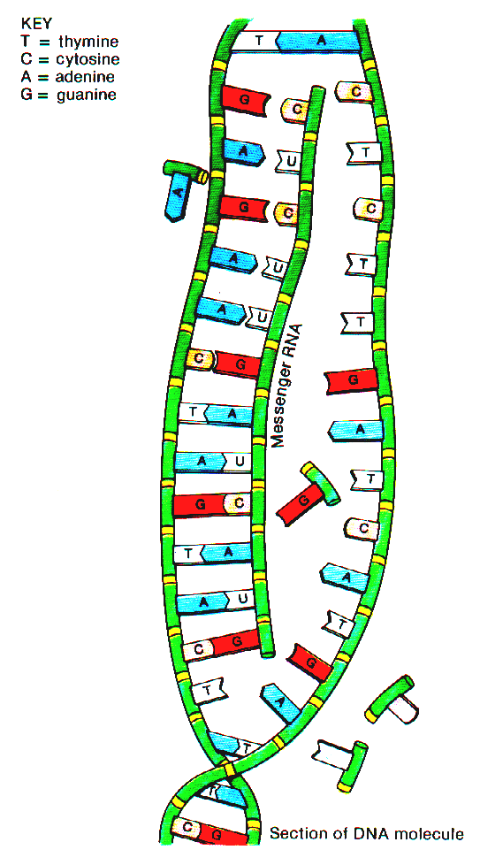
RNA
3 types:
mRNA – used in transcription
tRNA – used in translation
rRNA – component of ribosome

Slide 14
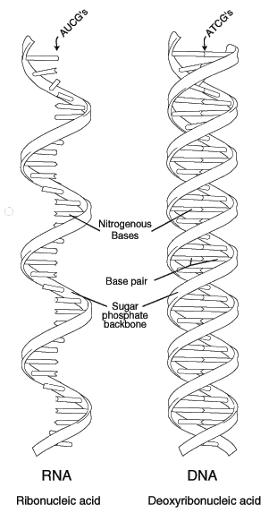
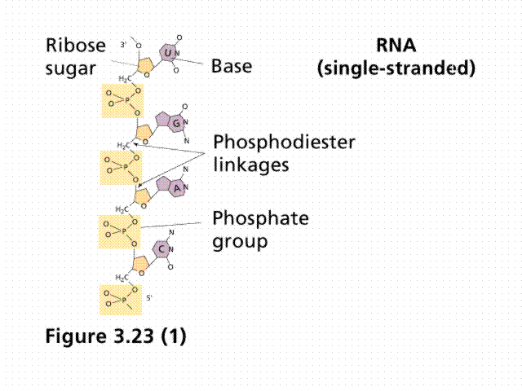

Slide 15
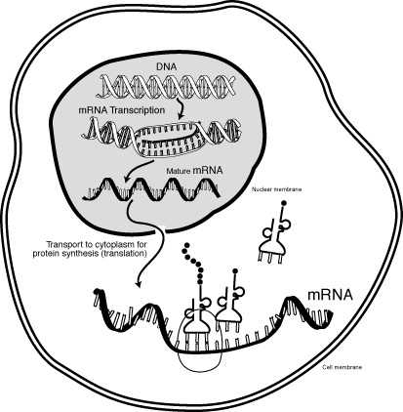
Info about Transcription
Step #1 (of 2) of protein synthesis
Starts in the nucleus
Uses 1 side of DNA as a template
Copies 1 gene at a time
Makes a section of mRNA

Slide 16
Transcription
transcribing DNA information (gene instructions) into mRNA which can leave the nucleus and go to the ribosomes in the cytoplasm
messenger RNA= mRNA (1 type of RNA)
special base sequences in DNA are recognized by RNA as “start” and “stop” signals
“Start” sequence called promoter region of DNA

Slide 17
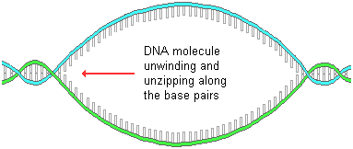
Details of the Process
1.RNA polymerase attaches to DNA and it separates the 2 DNA strands (unzips the strand)

Slide 18
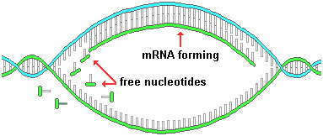
2. RNA polymerase synthesizes the mRNA strand using complimentary base-pairing

Slide 19
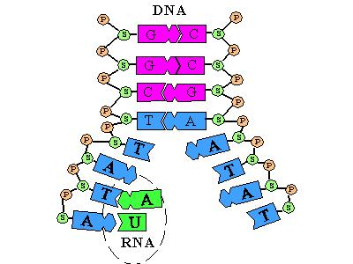
Remember…there aren’t “T” bases in RNA
“C” binds with “G”
DNA “A” binds with RNA “U”

Slide 20
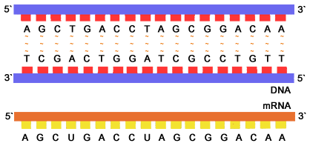
A
B
Which strand was copied? A or B

Slide 21
3. when RNA polymerase reaches the
end or "STOP" part of the genetic code for that protein, it releases
4. DNA re-zips
5. finished mRNA (messenger) leaves the nucleus and goes to a ribosome in the cytoplasm

Slide 22
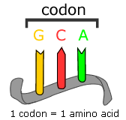
mRNA bases are grouped by 3
Each group of 3 nucleotides are called a codon (“code”)

Slide 23
Review of Transcription
Transcription occurs in the nucleus
The product of transcription is mRNA
Only 1 side of DNA is used as a template & only 1 gene is needed
Enzymes regulate the process

Slide 24
Translation
Making a protein (string of amino acids) from the information carried by mRNA.
Occurs in the ribosome.
A group of 3 mRNA bases makes up a “codon” (think of as a “code word”)
each codon specifies a particular amino acid
there are “start” and “stop” codons

Slide 25
Translation continued
mRNA travels from the nucleus and attaches onto the ribosome with codons
3 nucleotides of mRNA = codon
2nd kind of RNA= ribosomal RNA (rRNA)
makes up the majority of the ribosome

Slide 26
Translation continued
3rd kind of RNA= transfer RNA (tRNA)
carries amino acids to the ribosomes (amino acids join together to form proteins)
there are 64 different tRNA molecules (more than 1 for each amino acid)
3 nucleotides of tRNA that “match” or compliment the mRNA = anticodon

Slide 27
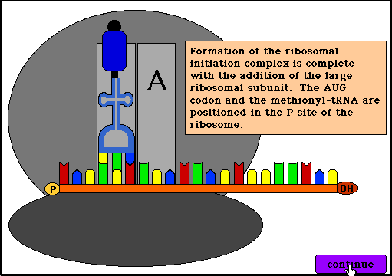
Translation continued
By matching the codon of mRNA to the anticodon of tRNA, the correct amino acid is put into place, then tRNA releases and leaves the amino acid in place.
Next tRNA goes here!!!!

Slide 28
amino acid
tRNA
anticodon
codon (mRNA)

Slide 29
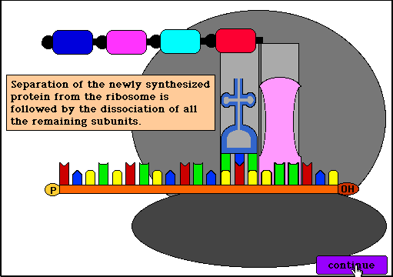
the protein is now finished & released!!

Slide 30
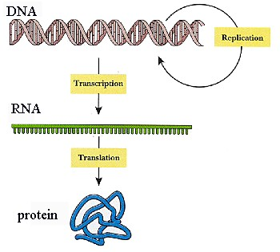
PROTEIN SYNTHESIS: All At Once

Slide 31
The genetic code
…is a correlation between the codon on mRNA and an amino acid
…there are stop & start codons

Slide 32
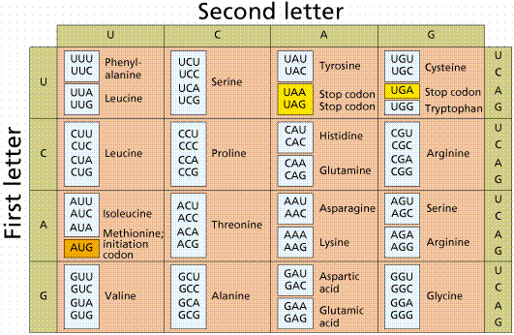
The Genetic code
Third letter

Slide 33
Review of Translation
Purpose is to make bring amino acids to the ribosomes to make proteins.
Translation occurs on the ribosomes as tRNA delivers amino acids. This occurs as the anticodons on the tRNA match up with the codons of the mRNA.
A start codon begins the process. Once the amino acids are delivered the tRNA leaves and gathers more. The stop codon ends the process and the amino acid chain makes a protein.

