Slide 1
March 12TH & 13TH 2018
Howdy yall

Slide 2
GATTACA Reflections
Turn to your group and discuss the following prompts
Think back to the pro- con articles. What are the negative impacts of genetic engineering on society? What are the positive impacts of genetic engineering on society
How might the movie convey the concept of “survival of the fittest”?

Slide 3
Pre- thinking
Is survival of the fittest something humans should “control”
Write 2-3 sentences about this concept in your notebook.

Slide 4
Vocab Activity
Vocab words
Traits
Adaptations
Variation
Survival of the fittest
Competition
Heritability
Differential reproduction
Gene pool
Over production
Descent with modification
Pick one vocab word from the box to the right
Draw a picture that depicts this vocab word
Please do not use any words, letters, or symbols.
When you are finished, pass the paper to the person to your left
Look at the drawing and pick a vocab word that fits with the image
Fold the drawing over and pass the paper to your left again
Repeat steps 1-5 until you have your original image

Slide 5
Share out!
Turn to your neighbors and discuss what you found?
Did your picture convey the correct vocabulary word? What did your paper start with? What word did it end with?

Slide 6
Natural Selection and Darwin’s theory
Write down all the words in black
Recall that all traits are passed from parent to offspring
How?
How did humans come to get the traits that we did?

Slide 7
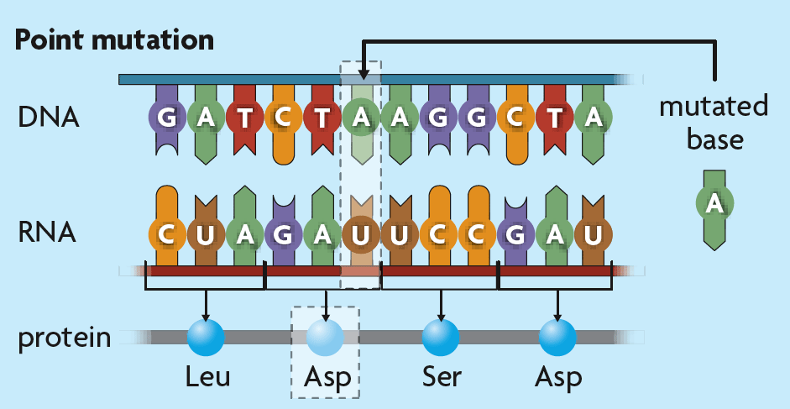
Recall: Genetic Variation
Mutation is a random change in the DNA of a gene.
can be passed on to offspring
Recombination forms new combinations of alleles.
Crossing over in meiosis produces genetically unique daughter cells.

Slide 8
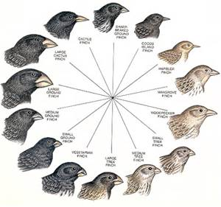
Finches: a closer look
There are many species of finch in the world.
Their characteristics and traits differ from species to species, as well as from bird to bird
We can look at the Finches that exist in the Galapagos islands as a case study for how each species developed different traits.

Slide 9
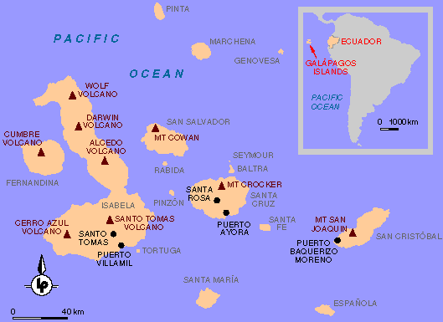
Where are the Galapagos Islands?
3
1
2
4
5
The Galapagos are a set of volcanic islands off of the coast of South America

Slide 10
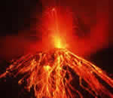
Ancestor of the Finches
The earliest finch species was found on South America.
There was only 1 species of finches 1 million years ago. It was the ANCESTOR.
There were NO FINCHES on the Galapagos Islands because the islands were not created until the VOLCANOS erupted.
When the islands were made, some finches were blown over by strong WINDS from South America.
Each island had different plants and ecosystems, meaning the birds had to adapt to find the right food
The finches with the beak that could open the seed had the ADVANTAGE

Slide 11
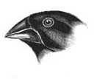
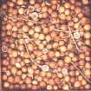
Which seeds is finch 1 adapted to eat?
Medium seeds
Hard seeds
Soft Seeds

Slide 12
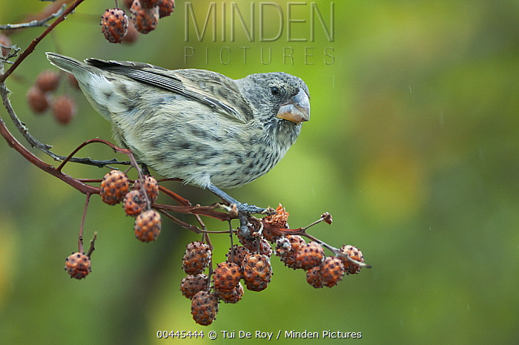
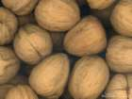
Which seeds is finch 2 adapted to eat?
Medium seeds
Hard seeds
Soft Seeds

Slide 13
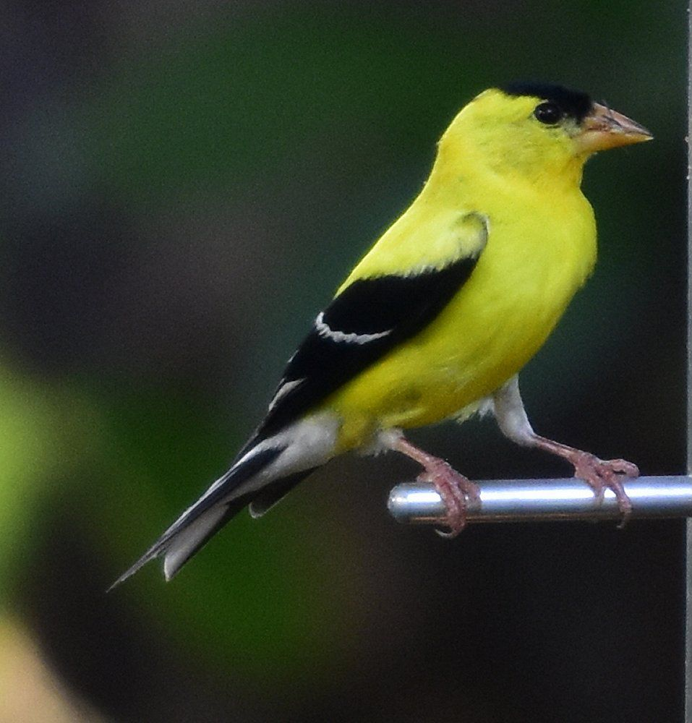
Which seeds is finch 1 adapted to eat?
Medium seeds
Hard seeds
Soft Seeds

Slide 14
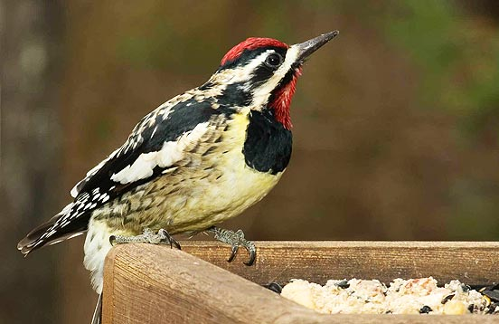
Which seeds is finch 1 adapted to eat?
Eats flies, not seeds
Medium seeds
Hard seeds
Soft Seeds

Slide 15
Traits and inheritance over time
The finches that had enough energy reproduced
Some of their offspring inherited the beak shape that allowed them to eat most successfully
Some didn’t– they did not live long enough to reproduce
Over time the finches who had the best beak were the only ones who reproduced on each island
They are now SEPARATE SPECIES and can only reproduce with their own species.
Good traits are passed down.

Slide 16
Do the finches support Darwin theory of natural selection?
Variation – There are different observable traits with in the species (at first).
YES
2) Competition - Individuals compete (fight) with other members of their own species for food and resources
YES
3) Differential reproduction - Those organisms best adapted eat more and have more babies.
YES
4) Heritability – Parents pass on their advantage to their babies
YES
Good Traits = Eat More = Have More Babies

Slide 17
What is Natural Selection
A process in which nature (the ecosystem) acts upon heritable characteristics, producing only the organisms who are best suited for their environment
AKA SURVIVIAL OF THE FITTEST

Slide 18
Natural Selection Cont’d
Variation: individuals within a population will look differently from one another
Descent with Modification: all offspring in a generation might look differently than their parents and their siblings
Adaption: Traits that helps animals survive and reproduce
Overproduction: Parents will produce more offspring than will survive to sexual maturity
All of these concepts work together to produce the BEST organisms for a certain ecosystem

Slide 19
video
https://www.youtube.com/watch?v=7VM9YxmULuo

Slide 20
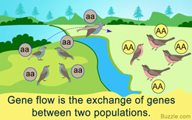
Gene flow is the movement of alleles between populations.
Gene flow occurs when individuals join new populations and reproduce.
Low gene flow increases the chance that two populations will evolve into different species.

Slide 21
Genetic drift is a change in allele frequencies due to chance.
Genetic drift causes a loss of genetic diversity.
It is most common in small populations.
One type of genetic drift is called the bottleneck effect

Slide 22
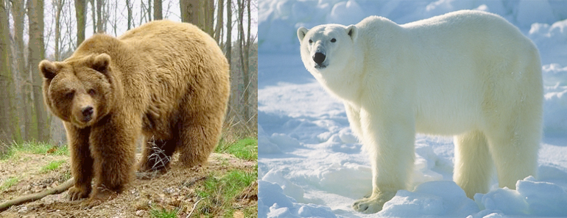
New species can arise when populations are isolated.
Populations become isolated when there is no gene flow.
Isolated populations adapt to their own environments.
Genetic differences can add up over generations.
Speciation is the rise of two or more species from one existing species.

Slide 23
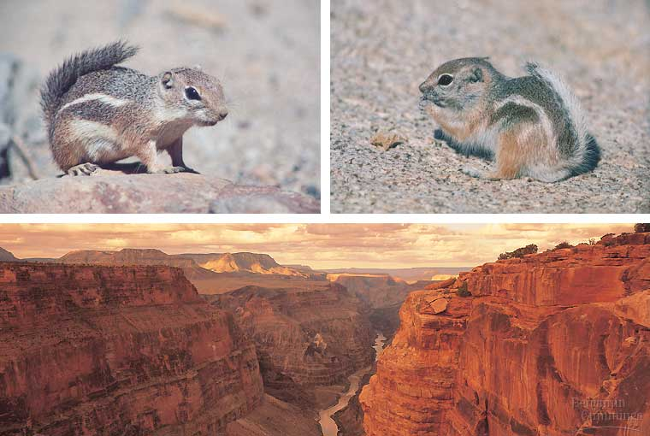
Geographic barriers can cause isolation.
called geographic isolation
physical barriers divide population

Slide 24
Test Re-take
Test Re-takes will occur next week Tuesday (3/19) after school only if the following is true
you got an “I” on both sections of the test
you Completed a study guide
You come in for office hours to complete test corrections with me BEFORE Tuesday

