Slide 1
March 26th and 27th , 2018

Slide 2
Hardy-Weinberg equilibrium
Hypothetical situation
serves as a hypothesis for a non-evolving population if you REMOVE all agents of evolutionary change
Establishes genetic equilibrium (no evolution), under these conditions:
1) A large breeding population
2) Mutations do not stay in the gene pool
2) Random mating
3) No immigration or emigration
4) No natural selection- no one trait is more advantageous over the others

Slide 3
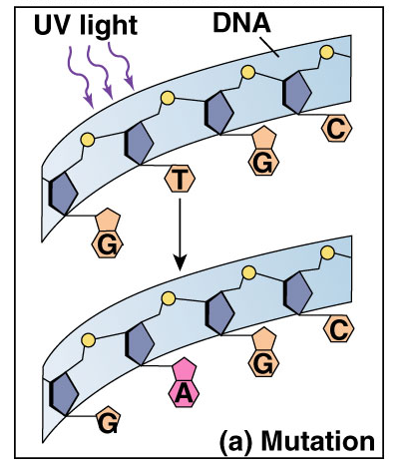
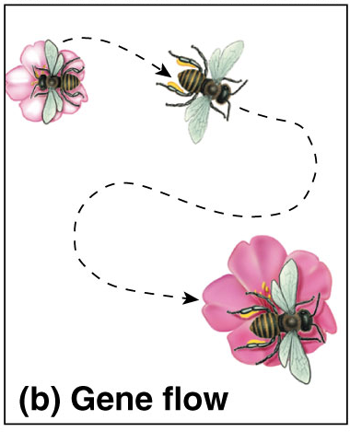
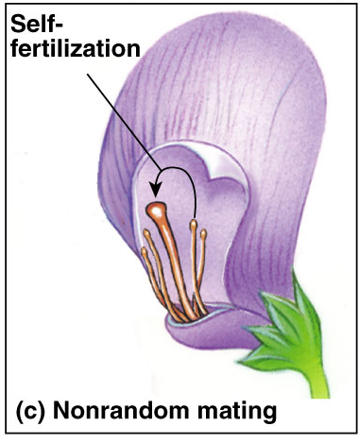
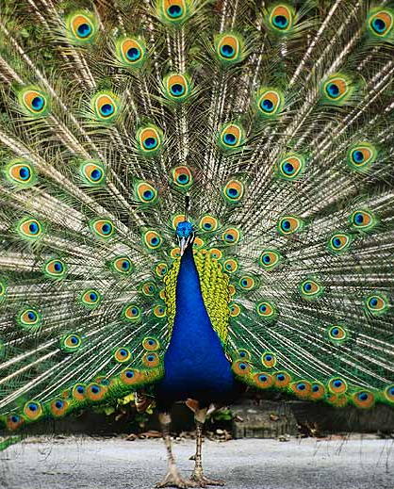
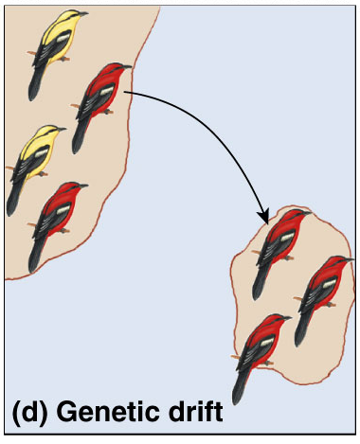
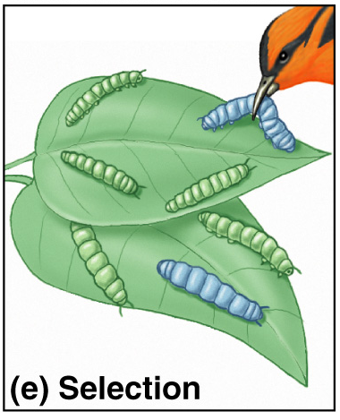
5 Agents of evolutionary change
Mutation
Gene Flow
Non-random mating
Chemical Changes to DNA
Migration
Sexual Selection
Genetic Drift
Selection
Small population
Natural Selection

Slide 4
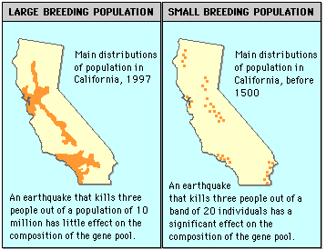
#1 Large Breeding Population
Helps to ensure that chance alone does not disrupt genetic equilibrium.
In a small population, only a few copies of a certain allele may exist. If for some chance reason the organisms with that allele do not reproduce successfully, the allele frequency will change.
This random, nonselective change
is what happens in genetic drift or a bottleneck event.

Slide 5
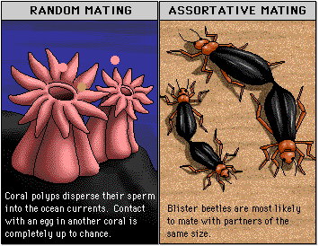
#2 Random Mating
In a population at equlibrium, mating must be random.
In assortative mating, individuals tend to choose mates similar to themselves; for example, large blister beetles tend to choose mates of large size and small blister beetles tend to choose small mates. Though this does not alter allelic frequencies, it results in fewer heterozygous individuals than you would expect in a population where mating is random.

Slide 6
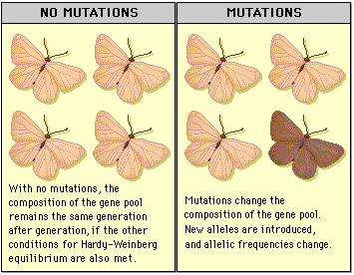
#3 No Change in Allelic Frequency Due to Mutation
For a population to be at Hardy-Weinberg equilibrium, there can be no change in allelic frequency due to mutation.
Any mutation in a particular gene would change the balance of alleles in the gene pool. Mutations may remain hidden in large populations for a number of generations, but may show more quickly in a small population.

Slide 7
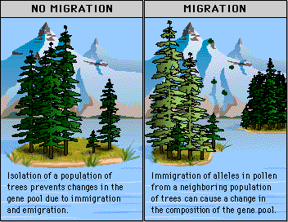
#4 No Immigration or Emigration
For the allelic frequency to remain constant in a population at equilibrium, no new alleles can come into the population, and no alleles can be lost.
Both immigration and emigration can alter allele frequency.

Slide 8
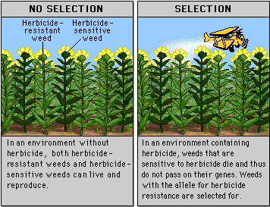
#5 No Natural Selection
In a population at equilibrium, no alleles are selected over other alleles.
If selection occurs, those alleles that are selected for will become more common. For example, if resistance to a particular herbicide allows weeds to live in an environment that has been sprayed with that herbicide, the allele for resistance may become more frequent in the population.

Slide 9
Hardy-Weinberg equilibrium
IF a population is NOT evolving, the frequencies of the alleles in its gene pool remain constant.
If p = frequency of dominant allele and q = frequency of recessive allele
Then, p + q = 1 AND p² + 2pq + q² = 1

Slide 10
Hardy-Weinberg Rule
P = dominant allele
q = recessive allele
Pq = heterozygote
P² = frequency of AA (homozygous dominant)
2Pq = frequency of Aa (heterozygous)
q² = frequency of aa (homozygous recessive)
So… ALGEBRA!
P + q = 1 all alleles in population
P²+2Pq+q² = 1 all genotypes … remember a genotype has 2 alleles!

Slide 11
Find q:
Take the square root of .012
= .109
Find q2:
12
1000 = .012

Slide 12
Find q2:
12
1000 = .012
Find q:
Take the square root of .012
= .109
Find p:
1- 0.109 =.89
Find p^{2:}
.89 ² = .79
Find 2pq:
2 (.79)(.109) = .172

Slide 13
q2:
12/
1000 = .012
p^{2:}
(.89 ² )= .79
2pq:
2 (.89)(.109) = .194
+
+
= 1 (or 0.996)

Slide 14
Find q:
Take the square root of .0023
= .048
Find q2:
30
130000 = .0023

Slide 15
Find q2:
30
130000 = .0023
Find q:
Take the square root of .0023
= .048
Find p:
1- .048 =.952
Find p^{2:}
.952 ² = .906
Find 2pq:
2 (.906)(.048) = .172

Slide 16
q2:
30/
130,000 = .0023
p^{2:}
(.952 ² )= .906
2pq:
2 (.906)(.048) = .086
+
+
= 1 (or 0.994)

Slide 17
Goldfish lab!!

