Slide 1
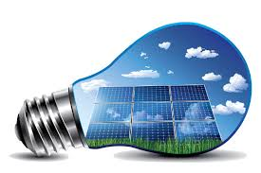
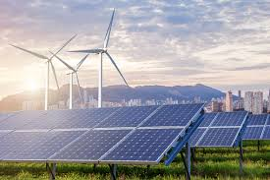
Renewable Energy

Slide 2
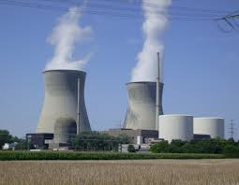
Current Energy Sources
Coal
Natural gas
Oil
We know these are all fossil fuels that have formed over millions of years underground
At the rate we are consuming them we will run out before 2200.

Slide 3
Renewable Energy Sources
Solar
Harnessing energy from the sun and turning into electricity
Wind
Harnessing energy from wind and turning it into energy
Biomass
Burning organic compounds for energy
Kinetic (piezo-electric)
Powered by movement

Slide 4
Solar Energy
Pro’s
Potentially 20 times less carbon emissions than fossil fuels
Solar energy can power LEDs at 100% efficiency
Minimal repairs overtime
Cons
Expensive to install (upwards of $20,000/building outfit)
Not many places to get solar panels (Lack of manufacturers)

Slide 5
Wind Energy
Pro’s
Lowest Carbon Emissions for installation
Easy to manufacture
Competitive prices
Easy to introduce to “the grid”
Con’s
Noise
Take up lots of space
Kills birds

Slide 6
Biomass
pros
Burning waste products and using that heat to generate electricity
Less carbon emissions (and less toxins released overall)
Some infrastructure for this already exists
Cons
Must grow the product to be burnt (corn/moss)
Have to burn a lot to get the same amount of energy
Less jobs created compared to solar or wind

Slide 7
Kinetic energy
Watches are the most common form of piezo electric electronics
Charge by the electron movement in the device
However, it is possible to transfer piezo electric energy to the grid
Cons
Super expensive to implement
Technology not 100% efficient yet
Pros
If developed correctly, stationary bikes, treadmills, or foot traffic could introduce energy back to the grid.

